Slide 1
How does Data
Influence the Aim
To Manage Change
To Impact the Aim
And Improve Process of Care
Jay Ford

Slide 2
Some is not a number, soon is not a time.
-- Don Berwick, MD

Slide 3
Quick Questions
What data is important?
Who uses this data?
How is this data utilized?

Slide 4
Using data to make decisions
Impact
Comparisons
Gaps
Direction
Problems
Cost Effective
Notes:
Identify problem areas (e.g., wait lists, billing)
Examine impact on client or staff outcomes
Identify gaps in service
Provide a strategic direction for change
Evaluate the impact of change on the agency
Determine if the change is cost-effective
Drive curiosity/questions about the change
Comparisons to statewide data
Share the results with the community
Secure new grants and contracts
Define and understand the problem
Use data in staff recruitment and hiring
Monitor and report program effectiveness
Examine geographic dispersion of clients
Create routine, simple reports to monitor progress

Slide 5
WHY IS THIS IMPORTANT?

Slide 6
Principle #5
Rapid Cycle Testing
Start by asking 3 questions
  What are we trying to accomplish?
  How will we know the change is an improvement?
  What changes can we test that will result in an improvement?
  Model for Improvement
  Reference: Langley, Nolan, Nolan, Norman, & Provost. The Improvement Guide, San Francisco, Jossey-Bass Publishers, 1996
Notes:
The 4th & 5th principles, Seeking change ideas outside the organization and Do rapid cycle testing, are address thru the PDSA Process Improvement model.
Ask three fundamental questions:
1. What are we trying to accomplish?
2. How will we know if a change is an improvement?
3. What changes can we test that may result in an improvement?
This is where we engage in idea generation - use the Nominal Group technique, looking at customer suggestions, try looking outside the agency for ideas, etc.
And once a promising change has been identified, rapidly use the Plan-Do-Study-Act (PDSA) cycle to turn a change idea into action:

Slide 7
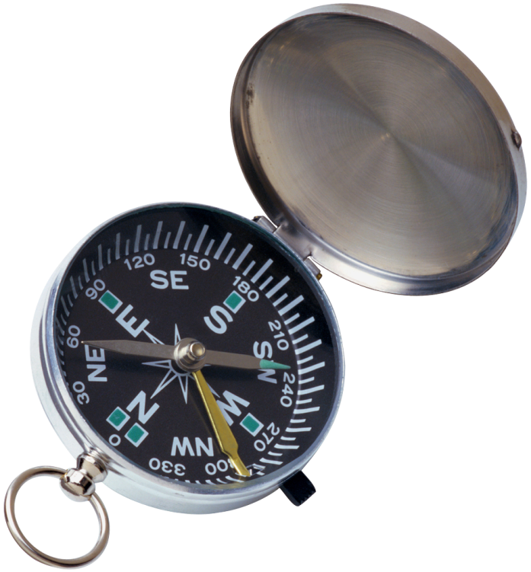
What do I need to Know?

Slide 8

A Quick Example
2 Categories
  Deposits
  Expenditures
Notes:
How does this knowledge help?
Deposits
Number of Deposits
Total Amount In
Expenditures
Number of Checks Written
Total Amount Out

Slide 9

What can you do with the knowledge?
Net Profit = Deposits - Expenditures
Hit Jackpot
Broke the Bank

Slide 10
What can you do with the knowledge?
Ask Questions
  What type of expenditures?
  When do they occur?
  Why did I experience a loss? Profit?
  What happened that was different this month?

Slide 11
What is the rest of the story?
1. Deposits
2. Expenditures
1. Total Deposits
2. Number of Deposits
3. Total Expenditures
4. Number of Expenditures
5. Net Profit or Loss

Slide 12

What are your aims?
Big A (for aim)
Reduce readmissions
Little A (for aim)
Intermediate measure

Slide 13

Making Changes
PDSA Cycles
  Plan the change
  Do the plan
  Study the results
  Act on the new knowledge
    Adapt
    Adopt
    Abandon
Two-week-long cycles
Notes:
13
Standard slide – please do not modify.
Pick a concrete example of a PDSA cycle and walk the audience through the story.
Example:
Plan: An agency decides to offer walk-in service on Wednesday afternoons
Do: The agency offers the walk-in hours on Wednesday afternoon for two weeks.
Study: No clients showed up for service during the walk-in hours—because the agency forget to notify their community that they were open for walk-ins.
Act: Adapt by continuing to offer walk-ins and by advertising the walk-in hours to their community.
Emphasis on short cycles—two or three weeks at the most.

Slide 14
Sample “Little A Data”
Admission:
In addiction treatment?
Medication adherence
In treatment:
Engagement/participation
Post Level:
Successful Transition

Slide 15
Cycle Measures
Cycle Measures: examine incremental impact of the PDSA change cycle
Three scenarios
  No shows
  Transitions between levels of care
  Time to treatment
Notes:
Outcome measures: inform the agency if changes are actually leading to improvement and achieving the stated aim.
Process measures: indicate to the team if a specific process change was accomplished and if it had the intended effect.
Mission Measures: support the agency mission.
What do we want to accomplish?
How does it support the agency mission?
Outcome measures: voice of the customer or patient.
How is the system performing?
What are the results?
Process measures: voice of the workings of the system
Are the parts/steps in the system performing as planned?
How will we know a change is an improvement?
Balancing Measures: looks at the system from different directions/dimensions
Is a change in one part of the organization impacting other process?

Slide 16
Cycle Measures
If the process measure is no-shows, what might be examples of a cycle measure
  Number of Missing Phone Numbers
  Number of Connected Calls
  Number of calls required
  % of persons called who come the next day
Notes:
Outcome measures: inform the agency if changes are actually leading to improvement and achieving the stated aim.
Process measures: indicate to the team if a specific process change was accomplished and if it had the intended effect.
Mission Measures: support the agency mission.
What do we want to accomplish?
How does it support the agency mission?
Outcome measures: voice of the customer or patient.
How is the system performing?
What are the results?
Process measures: voice of the workings of the system
Are the parts/steps in the system performing as planned?
How will we know a change is an improvement?
Balancing Measures: looks at the system from different directions/dimensions
Is a change in one part of the organization impacting other process?

Slide 17
Cycle Measures
  If the process measure is the percent of successful transfers from OP from Detox, what might be examples of a cycle measure
    Scheduled appointment within 48 hours of discharge
    Number of Calls required
    Number of Days between Discharge and Admission
    Number of clients offer to attend pre-discharge OP session
    Number of clients actually attending
Notes:
Outcome measures: inform the agency if changes are actually leading to improvement and achieving the stated aim.
Process measures: indicate to the team if a specific process change was accomplished and if it had the intended effect.
Mission Measures: support the agency mission.
What do we want to accomplish?
How does it support the agency mission?
Outcome measures: voice of the customer or patient.
How is the system performing?
What are the results?
Process measures: voice of the workings of the system
Are the parts/steps in the system performing as planned?
How will we know a change is an improvement?
Balancing Measures: looks at the system from different directions/dimensions
Is a change in one part of the organization impacting other process?

Slide 18
Data answers three common change project questions…..
How will you know which changes worked and which did not?
How will you know which changes resulted in an improvement?
Which change(s) is the most important and resulted in the most significant improvement?

Slide 19

Data directs the action steps toward a change project improvement goal.
Notes:
Why a dash board and not an Aging Report? Or the profit and loss statement?

Slide 20
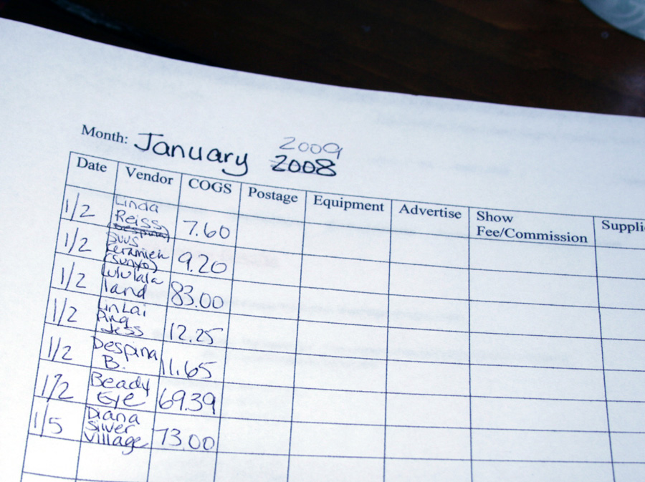
Keep data collection and reporting as simple as possible, but be specific.

Slide 21


A Step Process for Measuring the Impact of Change
6

Slide 22
6 Steps for Measuring the Impact of Change
1
DEFINE YOUR AIM & MEASURES
2
COLLECT BASELINE DATA
3
ESTABLISH A CLEAR GOAL
4
CONSISTENTLY COLLECT DATA
5
CHART YOUR PROGRESS
6
ASK
QUESTIONS
Always ask why.

Slide 23

2. Collect baseline data.
Never start a change
project without it.
QUESTIONS TO ASK:
Was the data defined to ensure that we collect exactly the information needed?
How accurate is the data? Does accuracy matter?
Does the process ensure that the measures will be collected consistently?
Do trade-offs exist? Is quality more important than the time required to collect data?

Slide 24

3. Establish a clear goal.
A goal should:
Be realistic yet ambitious
Be linked to project objectives
Avoid confusion
This ensures that the results are interpretable and accepted within the organization.

Slide 25

4. Consistently collect data.
As a team, decide:
Who will collect the data?
How will they collect it?
Where will the data be stored?
Monday
Regular data collection is a crucial part of the change process.
Tuesday
Wednesday
Thursday

Slide 26

5. Chart your progress.
Share pre-change (baseline)
and post-change data with:
  Change Team
  Executive Sponsor
  Others in the organization
Use visual aids for
sharing the data.
Line graph
Notes:
.

Slide 27
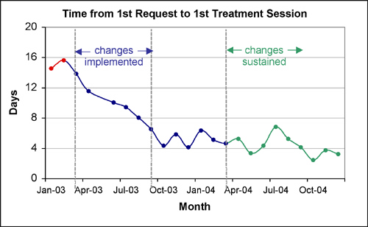
A simple line graph example
Remember: One graph, one message.

Slide 28

6. Ask questions.
What is the information telling me about change in my organization?
Why was one change successful and another unsuccessful?
Always ask why.

