Slide 1
WI Mental Health Collaborative
Round III
Change Leader Academy
Welcome
March 7, 2012
Session begins 8:30 a.m., ends 4:00 p.m.

Slide 2
Workshop Agenda
Welcome and Introductions
The NIATx Model
The Walk-through (Review of customer-process experience)
Break
Flowcharting
Nominal Group Technique
Lunch
Meet with your Coach
Plan, Do, Study, Act (PDSA)
Measuring Progress for Project Aims
Break
Designing Change Projects
Leading Change Teams Through Challenge
Next steps and Evaluation

Slide 3

Overview
The NIATx Model

Slide 4

Learning Objectives
To develop an understanding of the foundation of NIATx
Aims
Five Key Principles
The use of rapid-cycle change (PDSA) projects to transform your organization

Slide 5

Small Changes, Big Impacts
Welcome
Small changes create a big difference for both customers and staff
Effective changes don’t have to be expensive

Slide 6

Small Changes, Big Impacts
Story: By having follow-up (within 3 business days & offered WRAP) & Formalize Discharge Process. The resulting decrease in costs due readmission reductions was approx. $100,000+ per year.
Decreased 30 day readmission rate from 12% to 5%.
Waukesha

Slide 7
This is the NIATx model
People
Tools
1. Executive Sponsor
2. Change Leader
3. Change Team
1. Walk-through
2. Flowchart
3. NGT
4. PDSA Rapid Cycle
Testing
Change Project
aim
Using existing resources

Slide 8
Five Key Principles
Understand and involve the customer
Fix key problems–that keep the CEO awake
Pick a powerful change leader
Get ideas from outside the organization/field
Use rapid-cycle testing to establish effective changes

Slide 9
What is PDSA?

Slide 10
PDSA Cycle for Improvement
Act
Plan
What is your next
step?
What is the idea
or change to be
tested and for
how long?
Adopt, Adapt, or
Abandon?
Study
Do
What were the
results?
What steps are you
specifically making
to test this change?
How do they
compare with
baseline
measure?
Who is
responsible?

Slide 11
Base Your Change Project
on 5 Questions:
What is it like to be our customer?
What are we trying to accomplish?
How will we know if a change is an improvement?
What changes can we test that may result in an improvement?
How can we sustain the improvement?
Walk-through
Aim
Data – baseline and post change
PDSA Cycle
Sustainability
Plan

Slide 12
Who’s Who in
Process Improvement?
The Executive Sponsor articulates the vision and removes barriers to change.
The Change Leader motivates, empowers and leads the Change Team.
The Change Team plans and implements change cycles.

Slide 13
A
Valuable
Tool
Overview
Walk-through
Notes:
Facilitator should ask the group who has done the walk through?
If some participants have not done a walk through ask them to “report to you “ during the next break.
At Break ask them to
Look up agency phone number on the Internet directory
Call agency, identify themselves, and ask the person how long it would take to get an appointment

Slide 14
Learning Objectives
Participants will:
  Identify processes that are working
  Develop skills for identifying core problems and potential solutions
  Identify ways in which the walk-through might be used to engage the change team and set the stage for change

Slide 15
Why Walk-through?
The walk-through:
  Helps you understand the customer and organizational processes
  Provides a new perspective
    Allows you to feel what it’s like
    Lets you see the process for what it is
  Keeps you asking why…and why again.
  Walk-through template:
  http://www.niatx.net/Content/ContentPage.aspx?PNID=2&NID=143
  PI 101:
  http://www.niatx.net/PI101/Walkthrough/Index.htm

Slide 16
Walk-through
Report-out

Slide 17
Change Team Assignment
Thinking of your walk-through
experience, discuss the following:
1. Briefly describe the process of which you
conducted a walk-through.
2. What key strengths were identified?
3. What key process problems (opportunities)
were identified?
4. If you were the CEO, what would be
keeping you awake at night?

Slide 18
Process Strengths and Opportunities Report-out
Strengths
Opportunities

Slide 19
Take a Break

Slide 20
Going with the Flow
All you ever wanted to know about flowcharting
Jay Ford

Slide 21
The Patient Experience (Flowchart)
What is it like to be your patient?
Perform a detailed walkthrough and document your patients experience
Evaluate your findings and improve on the process
Tie in the ultimate patient experience with the ultimate revenue cycle
Notes:
Encourage people to complete a walk through. – Hand out the walk through instructions. Watch your competition and get ideas from outside the field. How does your dentist or doctor office handle insurance paperwork? Is it easy?
Other places to look – handling a new car loan, bank refinancing, paperwork as a POA for another family member. Lots of paperwork and confidential information, how to they tell you about it? Reassure you that it will be kept private? Help you figure out your authorization limits?

Slide 22
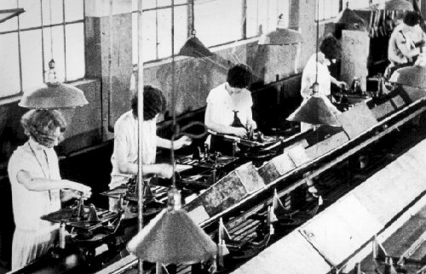
What is workflow?
  “The flow or progress of work done by a company, industry, department, or person.”

Slide 23
What is workflow?
Ingredients…
Events (tasks, decisions, phases)
Resources (labor, documents, technology)
Relationships (transferring, sequencing)
Responsibilities (ownership)
Information
Inputs/Outputs
Other Terms…
Flow
Process
System

Slide 24
How do you capture workflow?
Process Map
  A picture of all service steps provided to the client within a process and identifying responsibility for each.
Flowchart
  A picture of process steps in sequential order, including materials or services entering (input) or leaving (output) the process, decisions that must be made, people who become involved, time involved at each step and/or process measurements. Swim-lane diagram is uniquely formatted flowchart.
Spaghetti Diagram
  A picture that uses continuous flow line tracing the path of an item or activity through a process. The continuous flow line enables process teams to identify redundancies in and expedite workflow.
Value Stream Map
  A picture of a process that identifies (1) value added and (2) non-value added activities. Typically involves current vs. future states.
American Society of Quality (ASQ), www.asq.org. Visited on April 28, 2010.

Slide 25
Why Flowchart?
Flowcharting is useful for:
  Providing a starting point to understand the process as it is today.
  Identifying key problems/bottlenecks
  Showing where to test ideas for most impact
  Adding interactivity & fun - gets the team together
  Creating a simple & succinct visual process overview

Slide 26


Setting up a flowchart
Customer’s 1st phone
call to intake appointment.
Where does the
process begin?
Where does the
process end?
START
Customer
calls
office
Intake
appt.
completed
Title the process
you are
flowcharting.
END

Slide 27
Key Symbols for Flowcharts
Post-It Notes are great for flowcharting.
Action
A square identifies a step in the process
?
Yes
A diamond is a decision point in the process and asks a “yes or no” question or offers a choice of direction in the process.
No

Slide 28
Sample Flowchart
Process name: Customer 1st Contact (phone call) to Agency Response
START
1 person to answer phone
Receptionist
answers
phone?
Receptionist
able to help
customer?
Customer
phones agency
Yes
Yes
Receptionist “thanks” customer
Website
No
No
Walk-in
Customer routed to voicemail
Transfer customer to qualified staff person
Hang up phone
Referral
Other 1st Contact Options
Checked 1x per day
Staff not available
END

Slide 29

Why is capturing workflow important?
Visualize & Understand
Identify opportunities
Support process improvement
Educate others

Slide 30
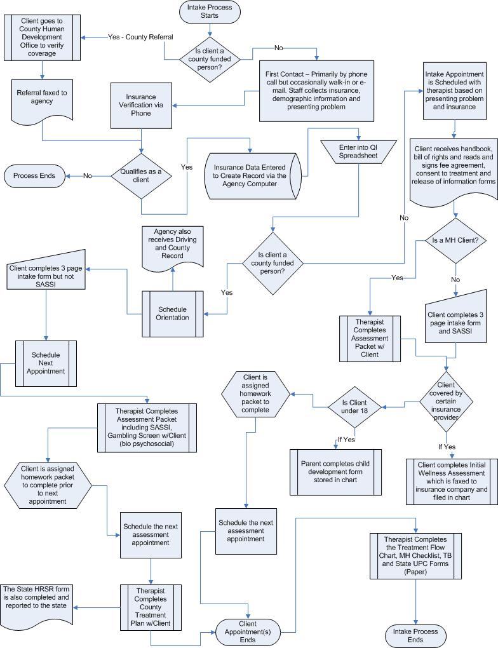
Typical information flow in Drug Treatment Agencies
Pre – screening process
Assessment/Intake Process
Admission (often an administrative formality)
Period where the client is in treatment
Discharge/Transfer Process

Slide 31
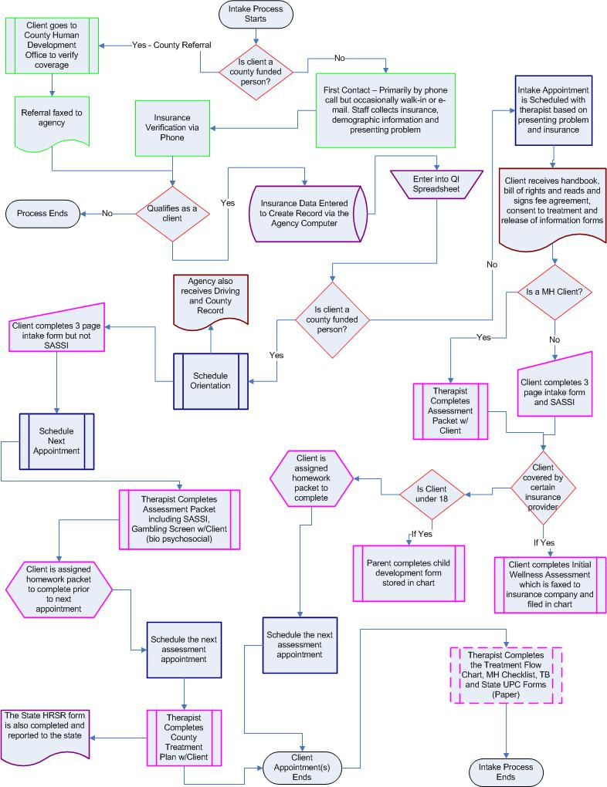
A Closer Examination of the Process shows
Four Screening Steps (Green)
Five Decision Points (Red)
Two Document Exchanges (Brown)
Three Double Entry Points (Purple)
Ten Paperwork completion steps by client and/or counselor (Pink)
Five Scheduling Events (Blue)

Slide 32
Barriers to Information Flow during the Intake Process
Double data entry
Eligibility screening
Multiple Intake Processes
  Level of Care
  Location

Slide 33
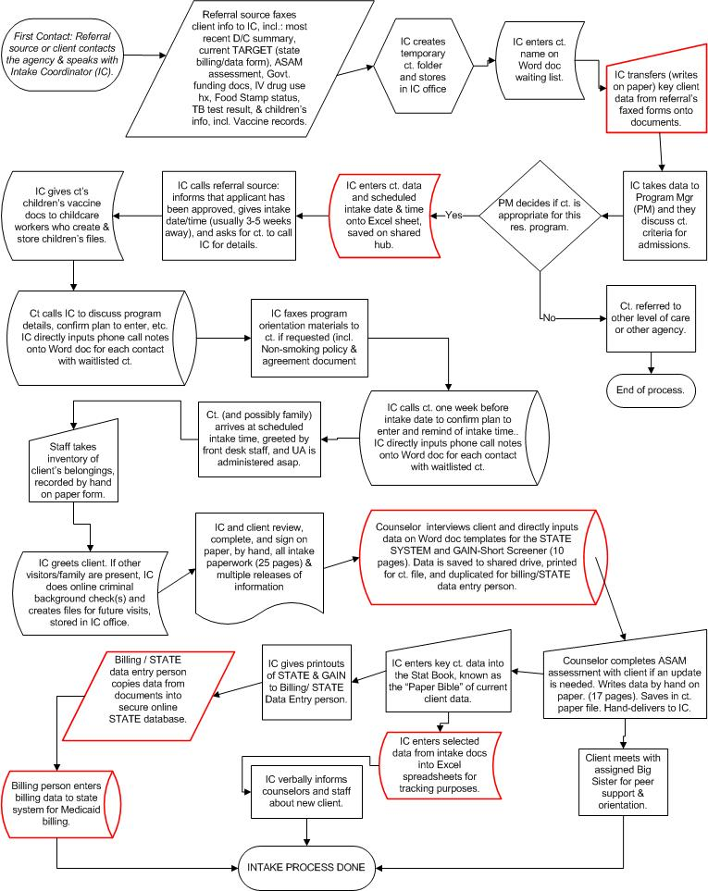
Barrier 2: Double Data Entry
Examples of Double Entry within the Agency
Examples of Double Entry for State Purposes

Slide 34
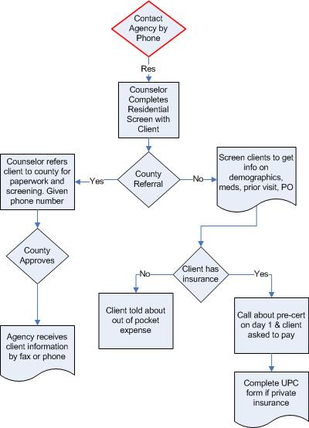
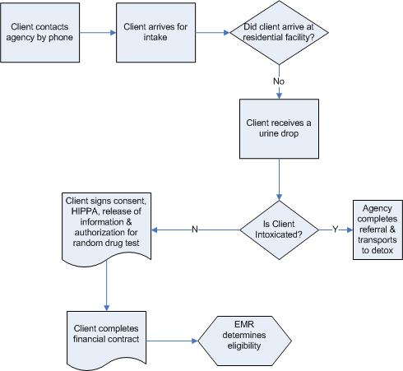
Barrier 2: Processes for Eligibility Screening
Agency A
Agency B

Slide 35
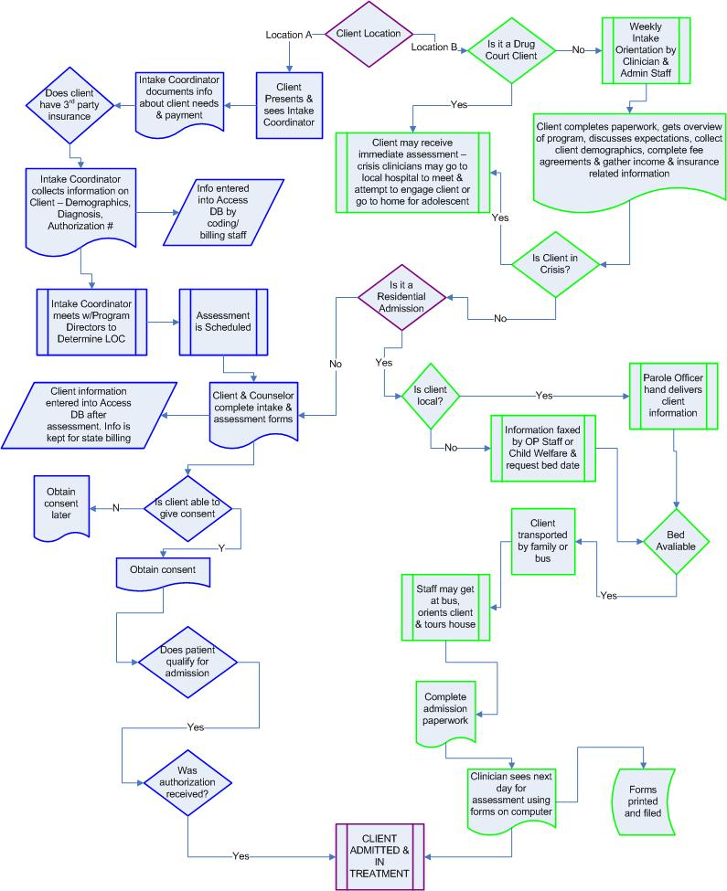
Barrier 3: Multiple Intake Processes by Location

Slide 36
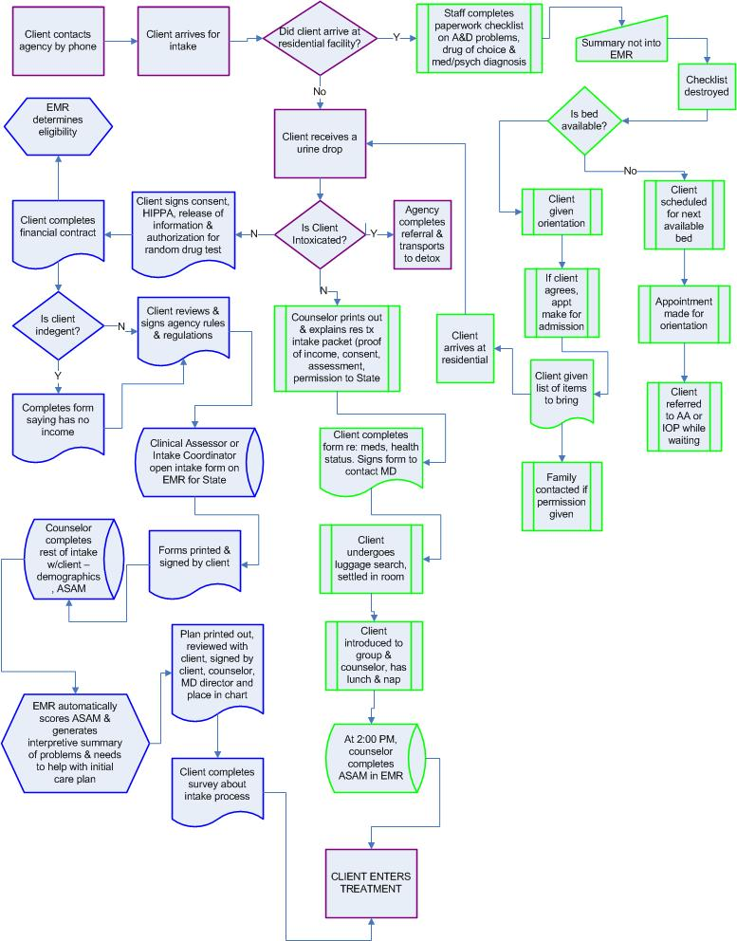
Barrier 4: Multiple Intake Processes by Level of Care

Slide 37
Assignment
Customer’s 1st phone
call to intake appointment.
Flowchart the process using results from a walk-through
START
Remember to:
Title the process
you are flowcharting.
Identify where does the
process begin? And where does the
process end?
Customer
calls
office
Intake
appt.
completed
END

Slide 38
Large Group Discussion
1. While flowcharting, what did you learn
about the steps you took while
conducting your walk-through?
2. How could you use your flowchart to
help engage your organization in the
change process?

Slide 39


NIATx opportunities for tomorrow
A
Valuable
Tool
Over 13,000 substance abuse treatment providers nationwide.
Nominal Group Technique
A Tool for Facilitators
Notes:
39

Slide 40
Role of a Facilitator
Help a group use better methods for
working together:
  How meetings are organized and run
  What happens before, during, and after discussions
  Structuring the decision-making process
  Exploiting all the talent at the table
  Dealing with roadblocks (a lack of participation, conflict between members, confusion about purpose or outcomes)

Slide 41
Making Better Decisions
What is a “good” decision?

Slide 42
Characteristics of a
Good Decision
Supported by the people who are affected by it
Based on all available facts and data (drawn from many people and sources) rather than opinion
Consistent with prior experience
Negative side effects are determined ahead of time and minimized
Meets the needs of those affected by the decision (e.g., customers, the team, co-workers)
Meets business needs—made on time, consistent with limits (scope, budget), serves the defined purpose

Slide 43
Two Ways You Can
Help Decision Making
Be clear about what decision is being made.
Add structure to your decision making process.

Slide 44
Adding Structure to
Decision Making…
Makes it clear what decision is being made
Allows everyone to participate
  Prevents people with authority or with loud voices from dominating
Often leads to a better decision as a result

Slide 45
Nominal Group Technique (NGT)
Designed to promote group participation in the decision making process
Uses priorities of each group member to discover the overall priorities of the group
Used by small groups to
  Reach consensus on the identification of key problems (NIATx Key Principle #2) or
  Develop solutions that can be tested using rapid cycles (NIATx Key Principle #5)

Slide 46
Generating Solutions
We have done a walk-through
We have created a flowchart
We have started to identify barriers
Now we need to identify problems and
possible solutions to test.
The NGT can help!

Slide 47
NGT (7 Steps)
Preparation (e.g., room and question)
Silent idea generation
Recording of ideas
Idea discussion
Preliminary voting
Discussion of preliminary voting
Final voting on ideas

Slide 48
Change Team Assignment
Assign a Change Leader to facilitate.

Slide 49
Step #1
Prepare the room:
    Flip chart or wall to post ideas
    Post-it notes
    Two colors of sticky dots for voting
Preparation:
      What is the question or problem statement?
      Write it at the top of your flip chart paper.

Slide 50
Step #2
  (5 Minutes)
Silent idea generation
  Record each idea you have on a separate sticky note

Slide 51
Step #3
(3 Minutes)
Recording of ideas (round robin)
  Go around the table and ask for each person to read one idea from their list; next person reads one idea--and so on
  Post each idea as it is read on the flip chart
  Refrain from discussion or clarification of ideas

Slide 52
Step #4
(5 Minutes)
Idea discussion
  Group can ask questions of each other to clarify the meaning of each idea.

Slide 53
Step #5
(1 Minute)
Preliminary voting – “What ideas can
we test first?”
  Each participant is allowed to cast votes for the idea they judge as most important
  For this step, you will each have three votes to cast

Slide 54
Step #6
(5 Minutes)
Discussion of preliminary voting:
  Brief discussion to ensure that everyone has the information they need to cast a final vote.

Slide 55
Step #7
(2 Minutes)
Final voting on ideas:
  Each participant casts one final vote
  Record all ideas for future reference and possible PDSA Cycles

Slide 56

Lunch (30 minutes)
_{and}
30 minutes to meet w/your coach

Slide 57
Overview
PDSA
Rapid Cycle Testing

Slide 58

Model for Improvement
1. What are we trying to accomplish?
2. How will we know that a change is an improvement?
3. What changes can we make that will result in an improvement?
Reference: Langley, Nolan, Nolan, Norman, & Provost. The Improvement Guide
A
P
S
D
Notes:
Nolan’s model--three questions and PDSA, but not just one PDSA. Difference between this and Juran is the emphasis on repeated PDSA cycles

Slide 59

Making Changes
PDSA Cycles
  Plan the change
  Do the plan
  Study the results
  Act on the new knowledge
    Adapt
    Adopt
    Abandon
Notes:
59
Standard slide – please do not modify.
Pick a concrete example of a PDSA cycle and walk the audience through the story.
Example:
Plan: An agency decides to offer walk-in service on Wednesday afternoons
Do: The agency offers the walk-in hours on Wednesday afternoon for two weeks.
Study: No clients showed up for service during the walk-in hours—because the agency forget to notify their community that they were open for walk-ins.
Act: Adapt by continuing to offer walk-ins and by advertising the walk-in hours to their community.
Emphasis on short cycles—two or three weeks at the most.

Slide 60
Plan
Define the change behaviorally… precisely what will be done?
Who will implement the change?
What preparation needs to be done before starting the change?
Clarify who will measure the change and who will review the data regularly to share with the team.

Slide 61
Do
Note the exact start date for the cycle
How long will the initial test last?
How often will the team meet to assess progress and review data?
During the test, the team considers what improvements might need to be made to improve the results

Slide 62
Study
After the agreed upon test period the team reviews the results
Change leader (or designated change team member) assembles and graphs the data for the team
The team deliberates what it has learned
Based on the learning, the team considers whether a change in strategy is in order

Slide 63
Act
(Adopt, Adapt, Abandon)
In light of what has been learned, the team decides what to do next
  Make an adjustment in the strategy to get closer to the objective
  Increase the objective (adapt) if the initial target has been met and the team believes even more progress can be made
  Combine another change (adapt) with the existing strategy to start a new cycle
  Abandon the existing strategy and start a new cycle

Slide 64
PDSA Cycles
Your team will learn a process:
A demonstration
Teams:
Change leader – complete the Change Project form
Data Coordinator – keep time and chart progress
Change team – implement changes

Slide 65
“Ball Toss” Game
  Improve your process using the following guidelines:
  Instructions:
    Must start & finish with the same person.
    Must touch everyone’s hands (both hands).
    Ball can only touch one person at a time.
    Must go in the same order every time.
  2. Collect baseline data
  3. Record your time.
  4. Make an improvement
  5. Repeat
  Data coordinator will graph each change.
Notes:
Count off by 6. (this should create teams of 7 to 8, which for this exercise is best.)

Slide 66

Change Project Form
Name of Organization: ___
PROJECT CHARTER
1. CHANGE PROJECT TITLE
2. What AIM will the Change Project address? Choose one aim and indicate baseline measure and target.
3. LOCATION
4. START DATE and expected completion date
5. LEVEL OF CARE
6. What CLIENT POPULATION are you trying to help, e.g. clients in a specific program?
7. EXECUTIVE SPONSOR
8. CHANGE LEADER
9. CHANGE TEAM MEMBERS
10. How will you COLLECT DATA to measure the impact of change?
11. What is the expected FINANCIAL IMPACT of this change project? How will the Executive Sponsor know?

Slide 67
Change Project Form
PDSA CYCLES
Rapid Cycle # | Cycle Begin Date | Cycle End Date | Plan What is the idea/change to be tested? | Do What steps are you specifically making to test this idea/change? Who is responsible? | Study What were the results? How do they compare with baseline measure? | Act What is your next step? Adopt? Adapt? Abandon?

Slide 68
Key Learnings
What essential information was required to improve?
What change concepts did you apply?
What data drove improvement?
How could you have improved as an improvement team?
Other key learnings?

Slide 69
Measuring Progress for Project Aims

Slide 70
How does Data
Influence the Aim
To Manage Change
To Impact the Aim
And Improve Process of Care
Jay Ford

Slide 71
Some is not a number, soon is not a time.
-- Don Berwick, MD

Slide 72
Quick Questions
What data is important?
Who uses this data?
How is this data utilized?

Slide 73
Using data to make decisions
Impact
Comparisons
Gaps
Direction
Problems
Cost Effective
Notes:
Identify problem areas (e.g., wait lists, billing)
Examine impact on client or staff outcomes
Identify gaps in service
Provide a strategic direction for change
Evaluate the impact of change on the agency
Determine if the change is cost-effective
Drive curiosity/questions about the change
Comparisons to statewide data
Share the results with the community
Secure new grants and contracts
Define and understand the problem
Use data in staff recruitment and hiring
Monitor and report program effectiveness
Examine geographic dispersion of clients
Create routine, simple reports to monitor progress

Slide 74
WHY IS THIS IMPORTANT?

Slide 75
Principle #5
Rapid Cycle Testing
Start by asking 3 questions
  What are we trying to accomplish?
  How will we know the change is an improvement?
  What changes can we test that will result in an improvement?
  Model for Improvement
  Reference: Langley, Nolan, Nolan, Norman, & Provost. The Improvement Guide, San Francisco, Jossey-Bass Publishers, 1996
Notes:
The 4th & 5th principles, Seeking change ideas outside the organization and Do rapid cycle testing, are address thru the PDSA Process Improvement model.
Ask three fundamental questions:
1. What are we trying to accomplish?
2. How will we know if a change is an improvement?
3. What changes can we test that may result in an improvement?
This is where we engage in idea generation - use the Nominal Group technique, looking at customer suggestions, try looking outside the agency for ideas, etc.
And once a promising change has been identified, rapidly use the Plan-Do-Study-Act (PDSA) cycle to turn a change idea into action:

Slide 76
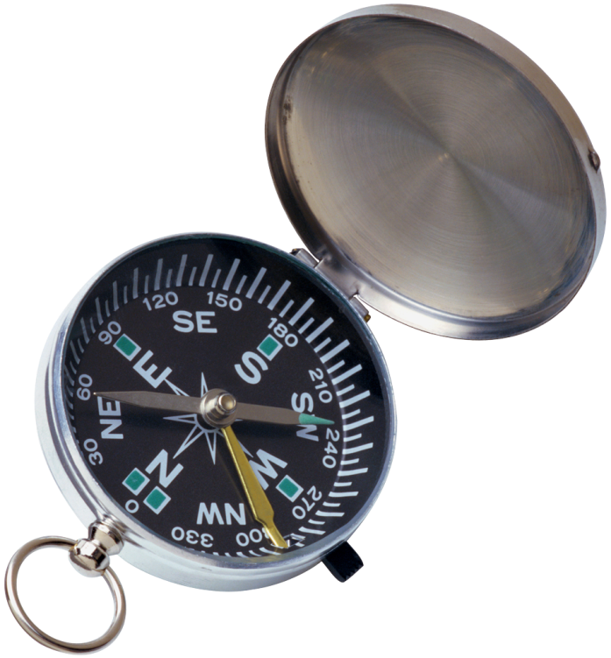
What do I need to Know?

Slide 77

A Quick Example
2 Categories
  Deposits
  Expenditures
Notes:
How does this knowledge help?
Deposits
Number of Deposits
Total Amount In
Expenditures
Number of Checks Written
Total Amount Out

Slide 78

What can you do with the knowledge?
Net Profit = Deposits - Expenditures
Hit Jackpot
Broke the Bank

Slide 79
What can you do with the knowledge?
Ask Questions
  What type of expenditures?
  When do they occur?
  Why did I experience a loss? Profit?
  What happened that was different this month?

Slide 80
What is the rest of the story?
1. Deposits
2. Expenditures
1. Total Deposits
2. Number of Deposits
3. Total Expenditures
4. Number of Expenditures
5. Net Profit or Loss

Slide 81

What are your aims?
Big A (for aim)
Reduce readmissions
Little A (for aim)
Intermediate measure

Slide 82
Making Changes
PDSA Cycles
  Plan the change
  Do the plan
  Study the results
  Act on the new knowledge
    Adapt
    Adopt
    Abandon
Two-week-long cycles
Notes:
82
Standard slide – please do not modify.
Pick a concrete example of a PDSA cycle and walk the audience through the story.
Example:
Plan: An agency decides to offer walk-in service on Wednesday afternoons
Do: The agency offers the walk-in hours on Wednesday afternoon for two weeks.
Study: No clients showed up for service during the walk-in hours—because the agency forget to notify their community that they were open for walk-ins.
Act: Adapt by continuing to offer walk-ins and by advertising the walk-in hours to their community.
Emphasis on short cycles—two or three weeks at the most.

Slide 83
Sample “Little A Data”
Admission:
In addiction treatment?
Medication adherence
In treatment:
Engagement/participation
Post Level:
Successful Transition

Slide 84
Cycle Measures
Cycle Measures: examine incremental impact of the PDSA change cycle
Three scenarios
  No shows
  Transitions between levels of care
  Time to treatment
Notes:
Outcome measures: inform the agency if changes are actually leading to improvement and achieving the stated aim.
Process measures: indicate to the team if a specific process change was accomplished and if it had the intended effect.
Mission Measures: support the agency mission.
What do we want to accomplish?
How does it support the agency mission?
Outcome measures: voice of the customer or patient.
How is the system performing?
What are the results?
Process measures: voice of the workings of the system
Are the parts/steps in the system performing as planned?
How will we know a change is an improvement?
Balancing Measures: looks at the system from different directions/dimensions
Is a change in one part of the organization impacting other process?

Slide 85
Cycle Measures
If the process measure is no-shows, what might be examples of a cycle measure
  Number of Missing Phone Numbers
  Number of Connected Calls
  Number of calls required
  % of persons called who come the next day
Notes:
Outcome measures: inform the agency if changes are actually leading to improvement and achieving the stated aim.
Process measures: indicate to the team if a specific process change was accomplished and if it had the intended effect.
Mission Measures: support the agency mission.
What do we want to accomplish?
How does it support the agency mission?
Outcome measures: voice of the customer or patient.
How is the system performing?
What are the results?
Process measures: voice of the workings of the system
Are the parts/steps in the system performing as planned?
How will we know a change is an improvement?
Balancing Measures: looks at the system from different directions/dimensions
Is a change in one part of the organization impacting other process?

Slide 86
Cycle Measures
  If the process measure is the percent of successful transfers from OP from Detox, what might be examples of a cycle measure
    Scheduled appointment within 48 hours of discharge
    Number of Calls required
    Number of Days between Discharge and Admission
    Number of clients offer to attend pre-discharge OP session
    Number of clients actually attending
Notes:
Outcome measures: inform the agency if changes are actually leading to improvement and achieving the stated aim.
Process measures: indicate to the team if a specific process change was accomplished and if it had the intended effect.
Mission Measures: support the agency mission.
What do we want to accomplish?
How does it support the agency mission?
Outcome measures: voice of the customer or patient.
How is the system performing?
What are the results?
Process measures: voice of the workings of the system
Are the parts/steps in the system performing as planned?
How will we know a change is an improvement?
Balancing Measures: looks at the system from different directions/dimensions
Is a change in one part of the organization impacting other process?

Slide 87
Data answers three common change project questions…..
How will you know which changes worked and which did not?
How will you know which changes resulted in an improvement?
Which change(s) is the most important and resulted in the most significant improvement?

Slide 88

Data directs the action steps toward a change project improvement goal.
Notes:
Why a dash board and not an Aging Report? Or the profit and loss statement?

Slide 89
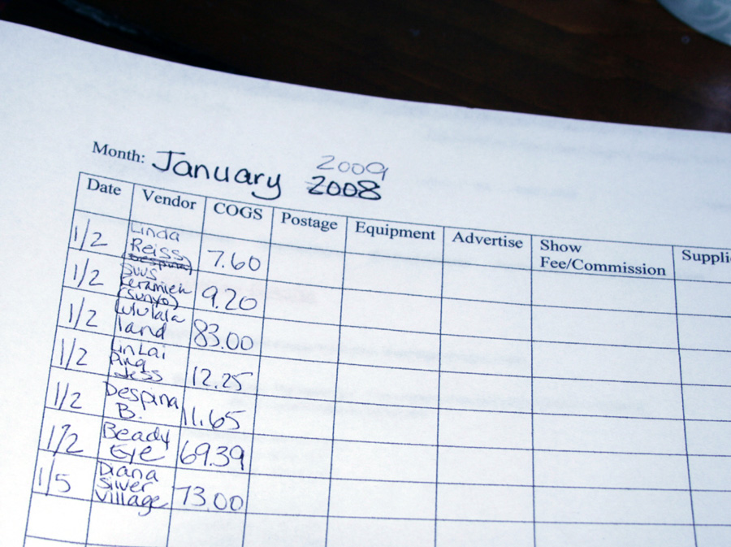
Keep data collection and reporting as simple as possible, but be specific.

Slide 90

A Step Process for Measuring the Impact of Change
6

Slide 91
6 Steps for Measuring the Impact of Change
1
DEFINE YOUR AIM & MEASURES
2
COLLECT BASELINE DATA
3
ESTABLISH A CLEAR GOAL
4
CONSISTENTLY COLLECT DATA
5
CHART YOUR PROGRESS
6
ASK
QUESTIONS
Always ask why.

Slide 92

2. Collect baseline data.
Never start a change
project without it.
QUESTIONS TO ASK:
Was the data defined to ensure that we collect exactly the information needed?
How accurate is the data? Does accuracy matter?
Does the process ensure that the measures will be collected consistently?
Do trade-offs exist? Is quality more important than the time required to collect data?

Slide 93

3. Establish a clear goal.
A goal should:
Be realistic yet ambitious
Be linked to project objectives
Avoid confusion
This ensures that the results are interpretable and accepted within the organization.

Slide 94

4. Consistently collect data.
As a team, decide:
Who will collect the data?
How will they collect it?
Where will the data be stored?
Monday
Regular data collection is a crucial part of the change process.
Tuesday
Wednesday
Thursday

Slide 95

5. Chart your progress.
Share pre-change (baseline)
and post-change data with:
  Change Team
  Executive Sponsor
  Others in the organization
Use visual aids for
sharing the data.
Line graph
Notes:
.

Slide 96
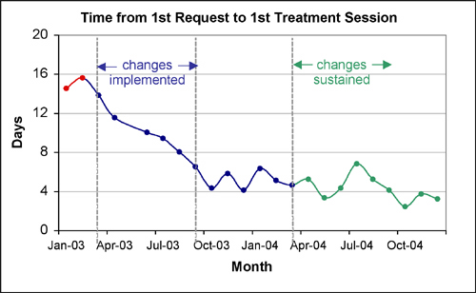
A simple line graph example
Remember: One graph, one message.

Slide 97
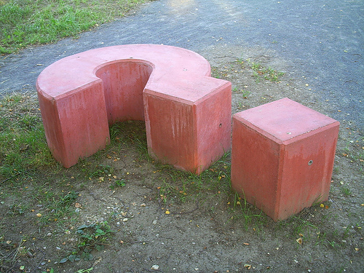
6. Ask questions
What is the information telling me about change in my organization?
Why was one change successful and another unsuccessful?
Always ask why.

Slide 98
Break – 15 minutes

Slide 99
Designing Change Projects
Overview

Slide 100
Model for Improvement
Aim
1. What are we trying to accomplish?
Data
2. How will we know that a change is an improvement?
3. What changes can we make that will result in an improvement?
Rapid Cycle
Change
Act
Plan
Reference: Langley, Nolan, Nolan, Norman, & Provost. The Improvement Guide
Study
Do
Notes:
Nolan’s model--three questions and PDSA, but not just one PDSA. Difference between this and Juran is the emphasis on repeated PDSA cycles

Slide 101
PDSA Cycle for Improvement
Act
Plan
What is your next
step?
What is the idea
or change to be
tested and for
how long?
Adopt, Adapt, or
Abandon?
Study
Do
What were the
results?
What steps are you
specifically making
to test this change?
How do they
compare with
baseline
measure?
Who is
responsible?

Slide 102
DEFEAT REPEATS
Presented by:
Kelly Randall, RN
Becky Manning, RN, APNP
Grant/Iowa Counties

Slide 103
AIM ADDRESSED
Decrease Hospital Readmission
  * In 2008, 167 Emergency Detentions
  59/167 were readmissions by 24 persons
  * In 2009, 80 Emergency Detentions
  13/80 were readmissions by 6 persons
  * In 2010, 50 Emergency Detentions
  14/50 were readmissions by 6 persons
  *From 3-29 through 10-06 each year

Slide 104
CHANGES
#1 DISCHARGE FOLLOW-UP
  Contact all clients within 2 business days following discharge
  #2 OUTREACH
  Client offered contact with social worker within 96 hours following discharge to develop WRAP (Wellness Recovery Action Plan)
  #3 STAFF TRAINING
  All on-call staff attended training on suicide assessment
  #4 OUTREACH
  Client offered contact with social worker OR established outpatient provider
  #5 ON-CALL CRISIS PLAN
  Developed from completed WRAP
  #6 DECREASE HOSPITAL LENGTH OF STAY
  Clients without discharge plan at final hearing closely monitored
  #7 CRISIS APPOINTMENT
  Crisis Appointments available daily

Slide 105
DATA
Plan Change #1
50 Emergency Detentions
27 Follow-up phone calls
14/50 out-of-county or non-UCS provider
3 readmissions prior to initial follow-up
1 deceased prior to initial follow-up
3 nursing home residents
2 discharged to jail
Plan Change #2
One Outreach Appointment by SW
Five Outreach Appointments by established provider

Slide 106
DATA
Plan Change #3
All on-call staff received 3 hour suicide assessment training from Dr. William Hutter. On-call document was revised to include a formal suicide assessment
Plan Change #4
Only two clients interested in working on WRAP, no completed WRAPs
Plan Change #5
Unable to complete d/t uncompleted WRAPs
Plan Change #6
Have not had to use yet!!
Plan Change #7
5 crisis appointments offered and accepted; diverted hospitalizations

Slide 107
CHANGES
#1 DISCHARGE FOLLOW-UP **
  Contact all clients within 2 business days following discharge
  #2 OUTREACH *
  Client offered contact with social worker within 96 hours following discharge to develop WRAP (Wellness Recovery Action Plan)
  #3 STAFF TRAINING (Good to do)
  All on-call staff attended training on suicide assessment
  #4 OUTREACH
  Client offered contact with social worker OR established outpatient provider
  #5 ON-CALL CRISIS PLAN
  Developed from completed WRAP
  #6 DECREASE HOSPITAL LENGTH OF STAY
  Clients without discharge plan at final hearing closely monitored
  #7 CRISIS APPOINTMENT **
  Crisis Appointments available daily

Slide 108
BOTTOM LINE DATA
75 Hospitalizations Diverted from 3/29 through 10/06.
Average Hospital Stay Costs the county $3000
SAVINGS=$225,000
In 2008, readmission rate=35%,
During Niatx Grant period, readmission rate=28%.
7% Decrease in hospital readmission:
        SAVINGS=$135,000
By reducing hospitalizations, we reduce the potential for rehospitalizations

Slide 109
Name of Organization:
1. CHANGE PROJECT TITLE
2. What AIM will the Change Project address? Choose one aim and indicate baseline measure and target.
3. LOCATION
4. START DATE and expected completion date
5. LEVEL OF CARE
6. What CUSTOMER POPULATION are you trying to help,
7. EXECUTIVE SPONSOR
8. CHANGE LEADER
9. CHANGE TEAM MEMBERS
10. How will you COLLECT DATA to measure the impact of change?
11. What is the expected FINANCIAL IMPACT of this change project? How will the Executive Sponsor know?

Slide 110
What is your aim or problem you are trying to solve?
Rapid Cycle # | Cycle Begin Date 2010 | Cycle End Date 2010 | Plan What is the idea/change to be tested? | Do What steps are you specifically making to test this idea/change? Who is responsible? | Study What were the results? How do they compare with baseline measure? | Act What is your next step? Adopt? Adapt? Abandon?
Notes:
ay

Slide 111
Leading Through Challenge
Café Session
Overview

Slide 112
Learning Objectives
Begin thinking of strategies for dealing with common roadblocks that are best dealt with by a Change Leader
Learn a method of brainstorming that includes all the people involved.

Slide 113
Reminder:
Role of a Change Leader
    Creating an environment where ongoing improvement is a way of life
      Champions the use of data, process thinking, and collaborative inquiry as an effective means to achieve goals
      Allocates resources (time, personnel) within the bounds of their authority
      Sponsors and guides project teams

Slide 114
Overcoming Organizational and Team Barriers
A key role of a Change Leader is to deal with organizational barriers that may be standing in the way, and to make sure a team keeps on track

Slide 115
Café Session
Participants “number off” (number of teams equal to the number of problem statements used)
Review problem statement examples around the room and assign a number to each
Assign a Scribe to each station
3 minute brainstorming session at each station
Move around the room clockwise

Slide 116
Example of problem questions
Examples in your workbook
Brainstorming can be done in person or virtually

Slide 117
Executive Sponsor buy-in and Involvement
The Executive Sponsor expressed an initial interest in the project and in your participation at the Change Leader Academy but has made little effort to meet with you to review progress, to meet with the Change Team, or to provide necessary resources, time, etc. to make the change a success. What are some things you might do, as the Change Leader, to get the Exec. Sponsor more engaged with and visibly supporting the change process in your organization?

Slide 118
Motivating Teams
Your Change Team has been working on the Change Project for several weeks and no progress has been made toward the project aim. The team appears to have little interest or enthusiasm to work on the Exec sponsor-selected project. As the Change Leader, what are some strategies and/or tactics you might use to engage and motivate the team and secure their buy-in for this project?

Slide 119
Time Management
The Exec. Sponsor has provided a strong rationale for the current Change Project. However, as the Change Leader, you are struggling to find the time to work on the project on top of an already bursting workload. Your Change Team is expressing the same concern, and as a result little progress is being made. How might you go about freeing up time on your schedule and others’ to allow the project to get off the ground?

Slide 120
Data Analysis
As a Change Leader, you understand the importance of using data to guide and measure change. Currently, your organization collects the right information but isn't using it effectively in the change process. What are some strategies/tactics you might use to increase the use of data to drive and promote change in your organization?

Slide 121
Debrief Café Session
Ask Scribe to read 2-3 ideas from each flip chart
Did you like this? Why?

Slide 122
Next Steps & Evaluations
Please complete an evaluation.
Thank you for coming!

