Slide 1


The Coordinated-Transitional Care
(C-TraC) Program:
A Transitional Care Option for Vulnerable Patients
Amy JH Kind, MD, PhD
Assistant Professor, Division of Geriatrics
University of Wisconsin School of Medicine and Public Health
Madison VA GRECC

Slide 2

Mr. V’s Story
89yo hospitalized with pneumonia
Discharged on oral antibiotics for an additional 5 days
Information told to patient in detail, but not to his family
Patient had unrecognized cognitive impairment. Forgot to fill antibiotic prescription.
Rehospitalized 14 days later
*photo credit: Annie Levy, 2010.

Slide 3
30 Day Rehospitalizations:
A Major Health System Problem
Affect 1 in 5 hospitalized Medicare patients
Account for over $30 billion annually
Major target in health reform
* Jencks et al, NEJM, 2009. 360: 1418-28.

Slide 4
Patient Protection and Affordable Care Act
Medicare Rehospitalization Reduction Program
  Public reporting of rehospitalization rates
  Payment penalties for 30 day rehospitalizations
    2012: CHF, MI, Pneumonia
    2015: COPD, CABG, Vascular Procedures
    All condition
  Funding of demonstration projects, bundled payments, Accountable Care Organizations (ACOs)
* MEDPAC, “Report to Congress: Promoting Greater Efficiency in Medicare”, June 2007: 103-120.
* Patient Protection and Affordable Care Act, H.R. 3590, Sec. 3025 (2010)

Slide 5
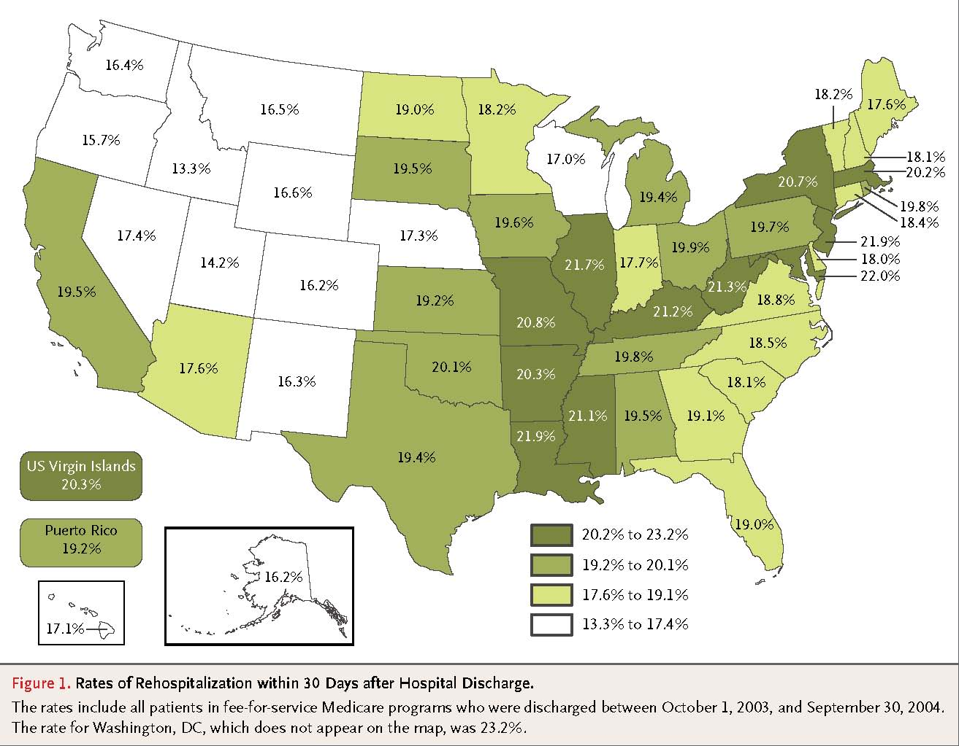
Rehospitalization Rates by Region¹
¹ Jencks et al, NEJM, 2009. 360: 1418-28.

Slide 6
The Problem:
Health System Fragmentation
Hospital
Primary Care
Nursing Home
Notes:
2001 Harris poll sponsored by the RWJ foundation showed chronically ill people see an average of 8 different MDs over one year.
Patients unable to advocate for themselves and/or transferring to another institution are at increased risk.
Remark on- increasing specialization of providers, DC summary needs to communicate care plan effectively to all settings

Slide 7
Contributors to
Health System Fragmentation
Organization of the health system into distinct, independent institutions (”silos”)
Lack of formal relationships/information systems between care settings
Communication between settings is often poor
Patients move frequently between care settings
Transitional care given little emphasis in traditional clinical training programs
* Coleman. JAGS. 2003;51: 549-555; Ma et. Al. J Am Geriatr Soc 2002; 49(4):S35.

Slide 8
Care Transitions Can Be Dangerous
41% of patients have laboratory tests pending at time hospital discharge; primary care providers are unaware of 61% of these
Poor communication of care plans to primary care provider can lead to inappropriate, delayed care
Over half of rehospitalized patients do not see their outpatient provider between the time of discharge and rehospitalization
*Roy et.al, Ann Int Med, 2005; Moore et al, Arch Int Med, 2007.; Jencks, NEJM, 2009.

Slide 9
Difficult for Patients to Overcome
Health System Fragmentation
Patients are often not prepared for next setting
Little patient empowerment in hospital
Lack of patient education
* Coleman. JAGS. 2003;51: 549-555.

Slide 10


Slide 11
Definition
Transitional Care: A set of actions designed to ensure the coordination and continuity of health care as patients transfer between different locations or different levels of care in the same location
* Coleman. JAGS. 2003

Slide 12

Transitional Care Services Combat
System Fragmentation
Health care staff bridge the hospital and home
Post-hospital home visits to teach patients about their care and conditions
Decrease rehospitalizations by about 30%
Not appropriate for all patients or settings
* Naylor, JAMA, 1996; Coleman, Archives, 2005.

Slide 13
Available Transitional Care Models:
Not Appropriate for Madison VA Hospital
Home visits impractical given patient dispersion
  Veterans travel up to 4.5 hours
  75% reside beyond the reach of a home visit
Currently available models exclude dementia
  Dementia increases rehospitalization risk by >40%
None tested within a VA setting

Slide 14
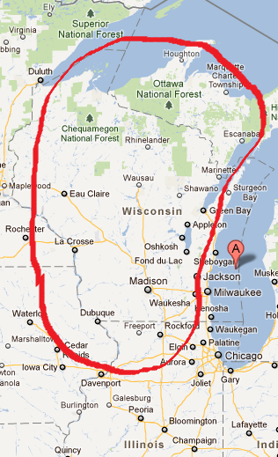

Slide 15
VA Coordinated-Transitional Care Program (C-TraC)
Phone-based program
Specially-trained RN nurse case manager
Protocolized encounters
Teachings based on theory of Spaced Retrieval*
  Method of learning information by practicing recalling that information over increasingly longer periods of time
  Applicable in early stages of dementia
Caregivers involved, activated at each step
* Bourgeois, et al, J Comm Disord, 2003; Camp et al, Appl Cog Psych, 1996.

Slide 16
C-TraC Goals
Educate and empower the veteran/caregiver in medication management
Ensure the veteran/caregiver has medical follow-up
Educate the veteran/caregiver regarding red flags
Ensure the veteran/caregiver knows whom to contact if questions arise

Slide 17
Veteran Eligibility
Hospitalized on non-psychiatric acute-care ward
Discharged to community
AND one or more of the following:
Have documentation of dementia, delirium or cognitive impairment
65 years or older AND
  lives alone OR
  had a previous hospitalization in past 12 months

Slide 18
Protocol: Identification
NCM = ‘Transitional Nurse-Case Manager’
Veteran identification
  NCM reviews daily electronic list of all hospitalized veterans
  NCM participates in daily multi-disciplinary discharge round on each targeted inpatient ward to offer transitional care and outpatient viewpoint to inpatient care team

Slide 19
Protocol: In-Hospital Visit
NCM meets with eligible veteran during their hospital stay for a brief educational intervention
    Introduction
    Medical follow-up
    Red Flags
    Contact information
Contact reinforced by a brightly colored ½ page handout documenting 3 red flags, date/time of next NCM call, date of next f/u appointment and contact information for NCM and triage nurse

Slide 20
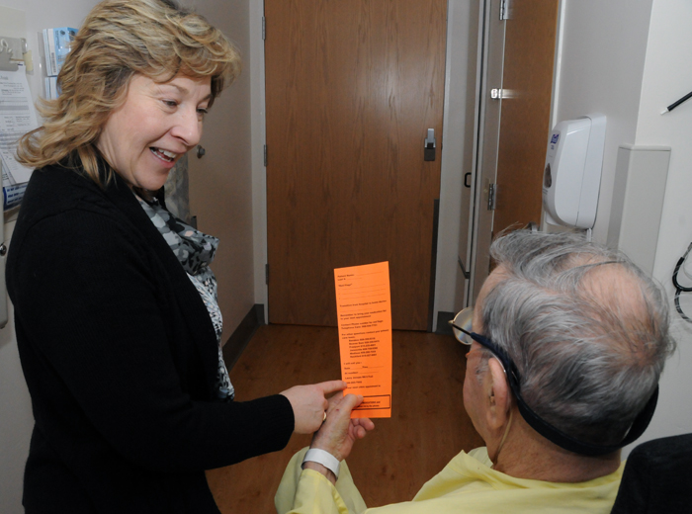
Protocol: In-Hospital Visit

Slide 21

Protocol: Telephone Follow-up

Slide 22
Protocol: Telephone Follow-up
Initial call is 48-72 hours of discharge with caregiver/veteran to reinforce
  Medication management
  Medical follow-up
  3 Red flags
  NCM contact information
Medication discrepancies or red flags prompt either a contact to the PCP or an appointment in urgent care

Slide 23
A Note on Medication Counseling
Veteran is asked to have all pill bottles in front of them during initial call
Veteran is asked: “Tell me how you take your medications.” NOT “Do you take drug X?”
Good medication reconciliation and counseling takes the bulk of the phone time during the follow-up calls
  Average 36min/call

Slide 24
Protocol: Telephone Follow-up
Veteran/caregiver is called weekly to reinforce the 4 major transitional care goals
Process ends when:
  Veteran sees PCP or
  Veteran and NCM agree that no further telephone follow-up is needed or
  Four weeks pass
Template documentation

Slide 25
Veterans Served
605 Veterans approached, enrolled over first 18 months
5 approached and refused (<1%)
Compares favorably to home-visit transitional care programs which can have >50% refusal rates*
~1/3 of veterans had caregivers
22% had dementia/cognitive impairment
* Stauffer et al, Archives, 2011; Voss et al, Archives, 2011

Slide 26
Characteristics

Slide 27
C-TraC Veterans’
Education Levels

Slide 28
Percent of Veterans with Medication Discrepancy Detected at 48-72h by C-TraC
Medication Discrepancy?

Slide 29
30-Day Rehospitalization Rates for Veterans in VA
C-TraC Program During
Baseline and Intervention Periods, Overall
Baseline (N=103)
Intervention (N=605)
Q = 3-month period (ie. quartile)
Average rehospitalization rates for baseline (34%) and intervention (23%), P-value = 0.013

Slide 30
Multivariate Analysis

Slide 31
Estimated Cost Avoidance
Total up-front program cost = $250/veteran enrolled
Gross direct cost avoidance of $966,167 over 18 months
After accounting for all programmatic costs, net cost avoidance of $1,225/veteran enrolled

Slide 32
Limitations
Single site
NCM not available on weekends/holidays
Current data relies on pre-post design
  Adjusted analyses, prolonged assessment to maximize rigor
  Multi-site trial would be stronger

Slide 33
Next Steps for C-TraC
Expansion to 2 other rural VA hospitals in Wisconsin/Upper Michigan (funding pending)
Expansion to non-VA hospitals

Slide 34
Conclusions
C-TraC is a feasible, low-cost program which decreases rehospitalizations in Madison VA Hospital veterans with high-risk conditions
C-TraC may represent a viable alternative for transitional care in VA, rural or other settings challenged by geographic distance, constrained resources or patients who refuse in-home visits
Next Steps: Multi-site Trial
Protocol/Tool Kit: available for free download at
www.hipxchange.org

Slide 35

Acknowledgements
Collaborators
Laury Jensen Steve Barczi
Alan Bridges Becky Kordahl
Maureen Smith Sanjay Asthana
Thank you
Madison VA Hospital veterans, caregivers and staff
and
Andrea Gilmore, Brock Polnaszek, Melissa Hovanes, Peggy Munson, Bert Landreth, Sheila Kelly and Megan Carey
Funding
Madison VA GRECC
VA T-21 Funding: Innovative Patient Centered Alternatives to Institutional Care
NIA Beeson Career Development Award (1K23AG034551)
UW Health Innovation Program

