Slide 1
Going with the Flow
All you ever wanted to know about flowcharting
Jay Ford

Slide 2
The Patient Experience (Flowchart)
What is it like to be your patient?
Perform a detailed walkthrough and document your patients experience
Evaluate your findings and improve on the process
Tie in the ultimate patient experience with the ultimate revenue cycle
Notes:
Encourage people to complete a walk through. – Hand out the walk through instructions. Watch your competition and get ideas from outside the field. How does your dentist or doctor office handle insurance paperwork? Is it easy?
Other places to look – handling a new car loan, bank refinancing, paperwork as a POA for another family member. Lots of paperwork and confidential information, how to they tell you about it? Reassure you that it will be kept private? Help you figure out your authorization limits?

Slide 3
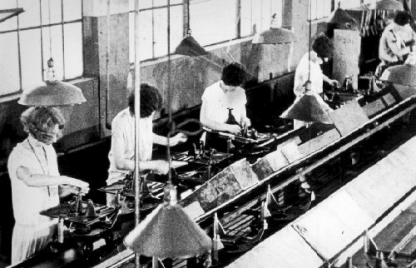
What is workflow?
“The flow or progress of work done by a company, industry, department, or person.”

Slide 4
What is workflow?
Ingredients…
Events (tasks, decisions, phases)
Resources (labor, documents, technology)
Relationships (transferring, sequencing)
Responsibilities (ownership)
Information
Inputs/Outputs
Other Terms…
Flow
Process
System

Slide 5
How do you capture workflow?
Process Map
A picture of all service steps provided to the client within a process and identifying responsibility for each.
Flowchart
A picture of process steps in sequential order, including materials or services entering (input) or leaving (output) the process, decisions that must be made, people who become involved, time involved at each step and/or process measurements. Swim-lane diagram is uniquely formatted flowchart.
Spaghetti Diagram
A picture that uses continuous flow line tracing the path of an item or activity through a process. The continuous flow line enables process teams to identify redundancies in and expedite workflow.
Value Stream Map
A picture of a process that identifies (1) value added and (2) non-value added activities. Typically involves current vs. future states.
American Society of Quality (ASQ), www.asq.org. Visited on April 28, 2010.

Slide 6
Why Flowchart?
Flowcharting is useful for:
Providing a starting point to understand the process as it is today.
Identifying key problems/bottlenecks
Showing where to test ideas for most impact
Adding interactivity & fun - gets the team together
Creating a simple & succinct visual process overview

Slide 7
Setting up a flowchart
Customer’s 1st phone
call to intake appointment.
Where does the
process begin?
Where does the
process end?
START
Customer
calls
office
Intake
appt.
completed
Title the process
you are
flowcharting.
END

Slide 8
Key Symbols for Flowcharts
Post-It Notes are great for flowcharting.
Action
A square identifies a step in the process
?
Yes
A diamond is a decision point in the process and asks a “yes or no” question or offers a choice of direction in the process.
No

Slide 9
Flowcharting your Vacation
We are planning a trip to Puerto Rico to get out of the Wisconsin Winter.
What is our starting point?
What decisions do we need to make?
What are some example steps in the process?
What is our ending point?

Slide 10
Sample Flowchart
Process name: Customer 1st Contact (phone call) to Agency Response
START
1 person to answer phone
Receptionist
answers
phone?
Receptionist
able to help
customer?
Customer
phones agency
Yes
Yes
Receptionist “thanks” customer
Website
No
No
Walk-in
Customer routed to voicemail
Transfer customer to qualified staff person
Hang up phone
Referral
Other 1st Contact Options
Checked 1x per day
Staff not available
END

Slide 11
Why is capturing workflow important?
Visualize & Understand
Identify opportunities
Support process improvement
Educate others

Slide 12
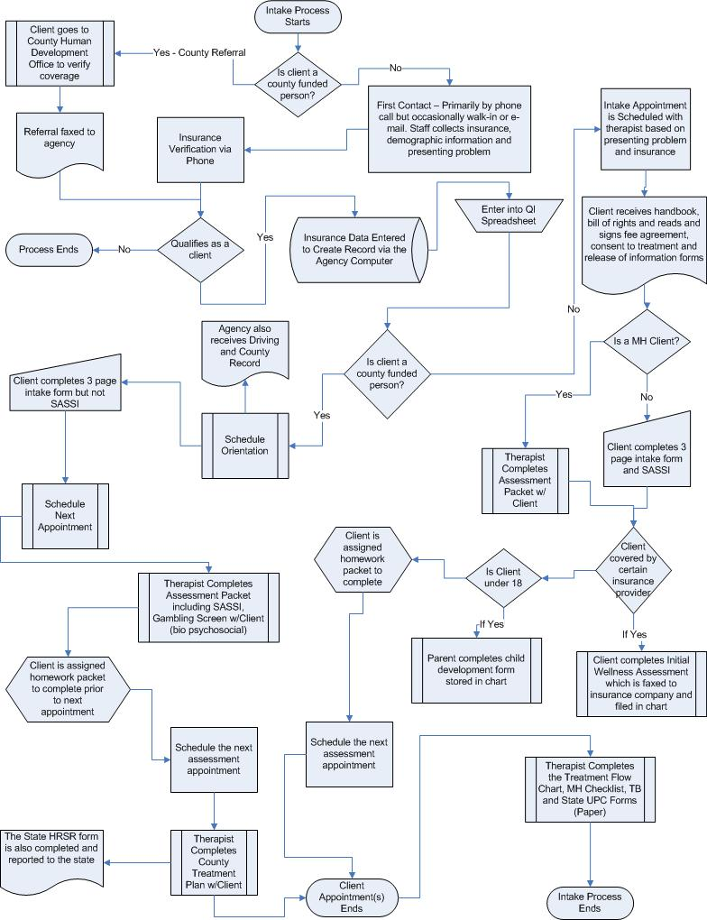
Typical information flow in Drug Treatment Agencies
Pre – screening process
Assessment/Intake Process
Admission (often an administrative formality)
Period where the client is in treatment
Discharge/Transfer Process

Slide 13
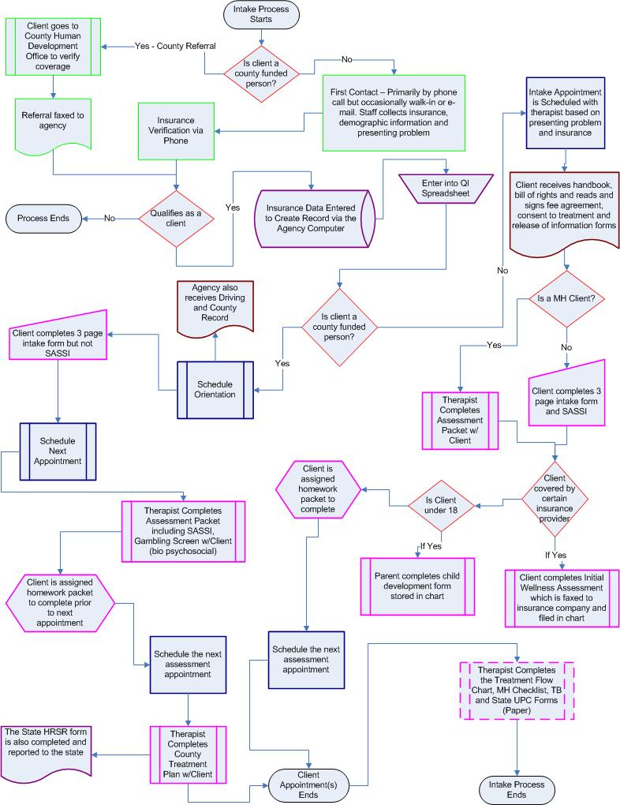
A Closer Examination of the Process shows
Four Screening Steps (Green)
Five Decision Points (Red)
Two Document Exchanges (Brown)
Three Double Entry Points (Purple)
Ten Paperwork completion steps by client and/or counselor (Pink)
Five Scheduling Events (Blue)

Slide 14
Barriers to Information Flow during the Intake Process
Double data entry
Eligibility screening
Multiple Intake Processes
Level of Care
Location

Slide 15
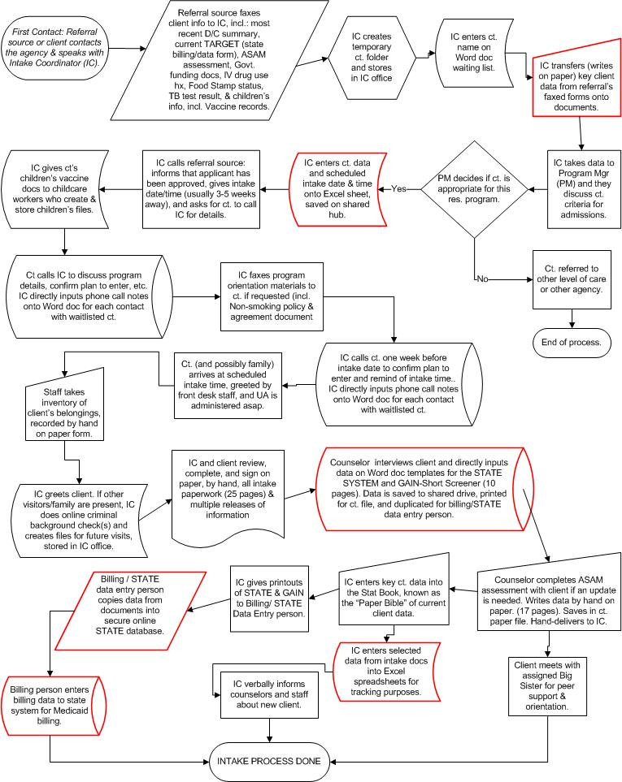
Barrier 2: Double Data Entry
Examples of Double Entry within the Agency
Examples of Double Entry for State Purposes

Slide 16
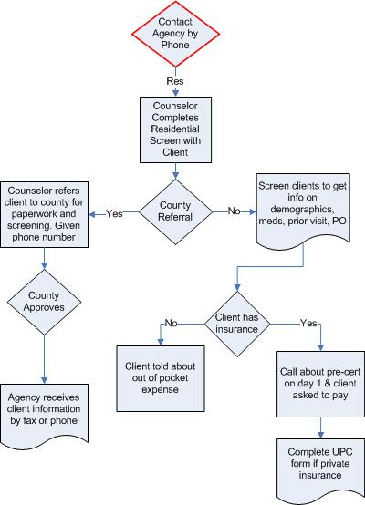
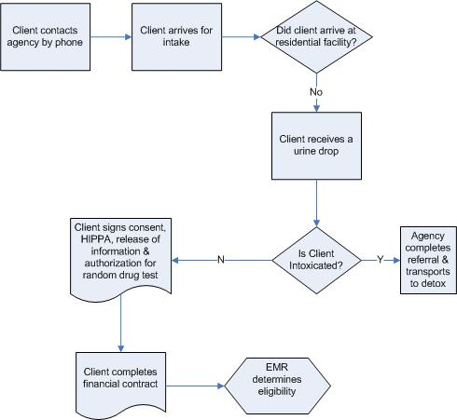
Barrier 2: Processes for Eligibility Screening
Agency A
Agency B

Slide 17
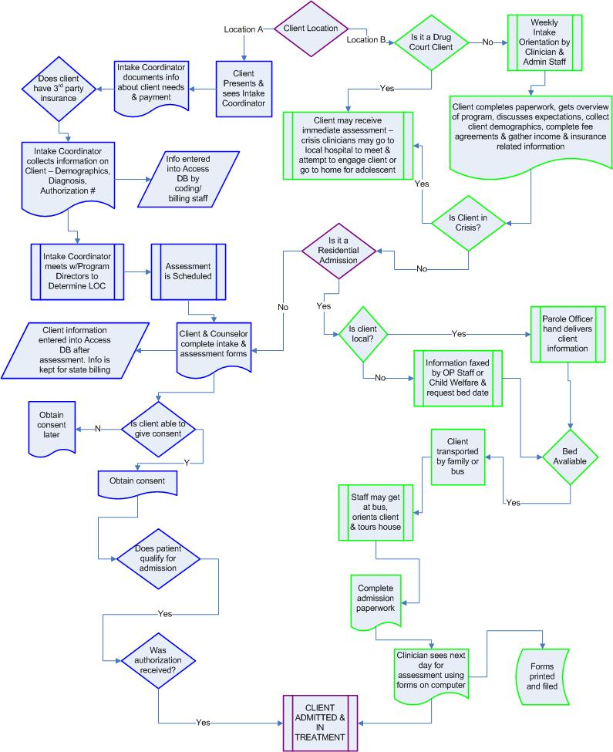
Barrier 3: Multiple Intake Processes by Location

Slide 18
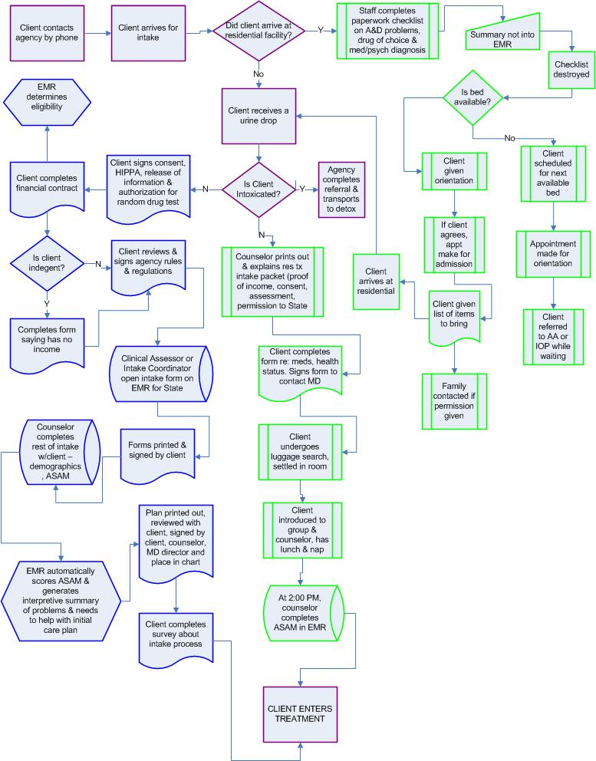
Barrier 4: Multiple Intake Processes by Level of Care

Slide 19
Assignment
Customer’s 1st phone
call to intake appointment.
Flowchart the process using results from a walk-through
START
Remember to:
Title the process
you are flowcharting.
Identify where does the
process begin? And where does the
process end?
Customer
calls
office
Intake
appt.
completed
END

Slide 20
Large Group Discussion
1. While flowcharting, what did you learn
about the steps you took while
conducting your walk-through?
2. How could you use your flowchart to
help engage your organization in the
change process?

