Slide 1

NIATx Model
Overview

Slide 2
What is a Change Leader?
A person who creates an environment positive change can occur
  Champions the use of data and process thinking, as an effective means to achieve goals
  Allocates resources (time, personnel) within the bounds of their authority
  Sponsors and guides project teams

Slide 3
NIATx History
RWJF and SAMHSA Supported
Evidence-based practices
Easy to adopt methods

Slide 4
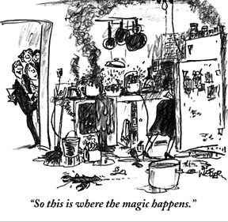
What is a process?
The steps we take in order to do something.

Slide 5
Why Process Improvement?
Everything we do is part of some process
Each of us serves others, or is served by processes of work.
85 percent of problems are caused by processes – not people.

Slide 6
Why Process Improvement?
“Your processes of work are perfect. They are perfectly designed to give you the results you are getting.”
- W. Edwards Deming, process improvement pioneer

Slide 7
Five Key
Improvement Principles

Slide 8
1. Understand & Involve the Customer
Most important of the Five Principles
What is it like to be a customer?
Your staff are customers, too.
Conduct walk-throughs.
Hold focus groups.
Notes:
8
Standard slide – please do not modify.
This is the most important factor of the Five Principles. Organizations that involve the customer are 14 times more liked to be successful than those that do not.
The collective importance of the 79 other factors in Gustafson’s research is outweighed by the importance of this principle alone.

Slide 9
Why a Walk-through?
The walk-through…
  Helps understand the customer and organizational processes
  Provides a new perspective
    Allows you to feel what it’s like
    Lets you see the process for what it is
  Seeks out and identifies real problems
  Generates ideas for improvement
  Keeps you asking why?…and why? again
Notes:
9
Standard slide – please do not modify.
Engage the audience: This is a good time to ask of anyone has done a walk-through before—and if so, what their experiences were.
If not, provide an example of your own from a recent walk-through experience.

Slide 10
2. Focus on Key Problems
What keeps the CEO awake at night?
What processes do staff and customers identify as barriers to excellent service?
Notes:
10
Standard slide – please do not modify.
Engage the audience: This is a good time to ask whether there are any CEOs in the audience. If so, ask them what issues keep them awake at night.

Slide 11
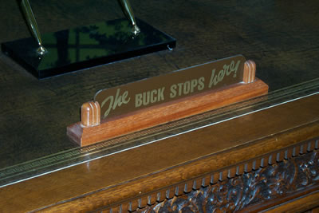
Key Roles:
Executive Sponsor

Slide 12
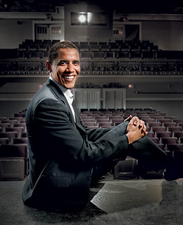

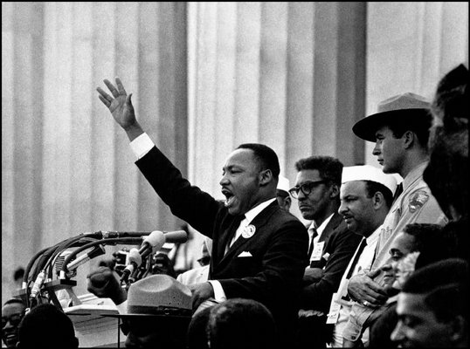
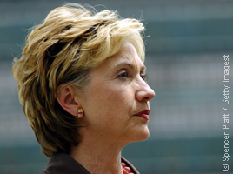
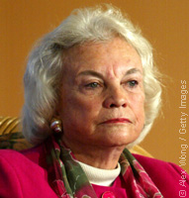
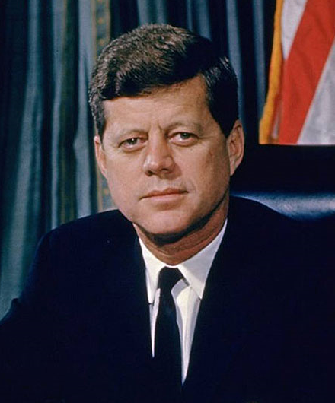
Executive Sponsor
Sonia Ghandi, President, Congress Party India
Martin Luther King
Barack Obama, President
Hilary Rodham Clinton,US Secretary of State
Sandra Day O’Connor
US Supreme Court Justice
John F Kennedy, President

Slide 13
Executive Sponsor
Vision
  Provides a clear link to a strategic plan
  Sets a clear aim for the Change Project
Engagement
  Supports the change leader
  Periodically attends change team meetings
  Personally invites change team participants
Leadership
  Removes barriers to change
  Connects the dots
  Communicates clearly, concisely, and constantly
Notes:
13
Standard slide – please do not modify.
This is the role of the Executive Sponsor in a Change Project.
Give particular emphasis to the personal invitation to join the Change Team.
Example:
An invitation, using if possible the name of someone in the audience, to join a Change Project for a certain amount of time (two months, for example) to help achieve a clear goal (decrease waiting time from 30 days to 0 days, for example).

Slide 14
3. Powerful Change Leader
The Change Leader must have…
  Influence and respect across levels of the organization
  A direct line to the Executive Sponsor
  Empathy for all staff members
  Time devoted to leading Change Projects
Notes:
14
Standard slide – please do not modify.
There are two aspects of the Change Leader that are particularly important: the ability to make connections with both the CEO and the rest of the staff and the ability to devote time to the Change Project.

Slide 15
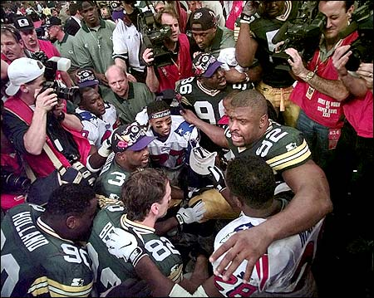

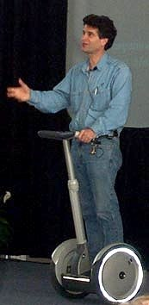
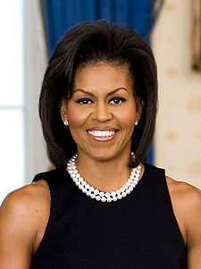
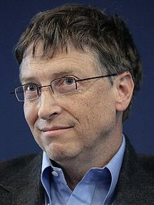

Key Roles: Change Leader
Reggie White
Queen Rania of Jordan
Dean Kamen
Michelle Obama
Bill Gates
Oprah Winfrey
Notes:
A Change Leader is respected by his or her colleauges.

Slide 16
Leadership Characteristics
Overall Perspective
Change Leader Characteristic Survey
29 Categories, 99 responses - Change leaders (n = 40)/Executive sponsors (n=20)/Change teams members (n=39)
Notes:
16
Standard slide – please do not modify.

Slide 17

Key Roles: Change Team

Slide 18
What do Change Team
Members look like?
Front line workers and supervisors in unit where changes will be implemented
Other employees impacted by the change
People with special knowledge about the change, e.g. alumni, family members, IT staff

Slide 19
Change Team Responsibilities
Identify possible changes that could meet the objective
Decide how to implement the change
Create and conduct rapid-cycle pilot tests until goal is achieved
Study results to see if the change should be adopted, adapted or abandoned

Slide 20
4. Ideas from Outside Organization
Real creative problem solving comes from looking beyond the familiar.
Provides a new way to look at the problem
  Client Engagement
    Northwest Airlines
    Ford Motor Company
  Reduce no-shows through reminders
    Dentist Office
    Public Libraries
  Client Handoffs
    National Rental Car
    Hyatt Place Hotels
Notes:
20
Standard slide – please do not modify.
Importance of looking outside for ideas for solving problems.
Engage the audience by asking for ideas from outside the field—though beware that the audience may not respond.
Specific examples:
Northwest Airlines: automatic notification of cancellations and delays via telephone (confirmation calls).
Ford: Their sales approach varies depending on the model that they are selling (individualized services).
Dentist and Library: confirmation calls with automated voice processing.
National Rental Car: seamless transitions from the airport to checkout of the car to return the car to airport.
Hyatt Place Hotels: automated check-in and checkout by credit card to get key without personal interaction.

Slide 21
5. Rapid-cycle Testing
Start by asking three questions:
  What are we trying to accomplish?
  How will we know a change is an improvement?
  What changes can we test?
  Model for Improvement
  Langley, Nolan, Nolan, Norman, & Provost. The Improvement Guide, San Francisco, Jossey-Bass Publishers, 1996
Notes:
21
Standard slide – please do not modify.
These are the basic questions to ask at the beginning of any Change Project.
Examples of Answers:
Reduce waiting times from 30 days to less than 10 days.
By measuring the number of days until the next available appointment.
Identify possible changes: this is a good time to refer back to problems identified by the CEO or the walk-through.

Slide 22
What makes this approach to change different?
Change is a big experiment
No mistakes, no right or wrong
Data tells you if the change was an improvement
Customer guides change ideas

Slide 23
PDSA Cycle for Improvement
Act
Plan
What improvement will we make next?
Do we need to: Abandon? Adapt? Adopt?
Sustain the gain
Objective
Questions and
predictions (why)
Plan to carry out
the cycle (who,
what, where, when)
Study
Do
Complete the analysis of the data
  Compare data to
  predictions
    Summarize
    what was
    learned
Carry out the plan
Document problems
and unexpected
observations
Begin analysis
of the data

Slide 24
This is the NIATx model
People
Tools
1. Executive Sponsor
2. Change Leader
3. Change Team
1. Walk-through
2. Flowchart
3. NGT
4. PDSA Rapid Cycle
Testing
Change Project
aim
Using existing resources

