Slide 1
How does Data
Influence the Aim
To Manage Change
To Impact the Aim
And Improve Process of Care
Jay Ford

Slide 2
Some is not a number, soon is not a time.
-- Don Berwick, MD

Slide 3
Data Framework
What data is important
Who uses this data?
Make Key Decisions
How is this data utilized?
Provide Comparisons
Identify Gaps/Problems
Assess direction
Measure impact of change

Slide 4
WHY IS THIS IMPORTANT? Principle #5 - Rapid Cycle Testing
What are we trying to accomplish?
How will we know a change is an improvement?
What changes can we test that will result in an improvement?
Notes:
The 4th & 5th principles, Seeking change ideas outside the organization and Do rapid cycle testing, are address thru the PDSA Process Improvement model.
Ask three fundamental questions:
1. What are we trying to accomplish?
2. How will we know if a change is an improvement?
3. What changes can we test that may result in an improvement?
This is where we engage in idea generation - use the Nominal Group technique, looking at customer suggestions, try looking outside the agency for ideas, etc.
And once a promising change has been identified, rapidly use the Plan-Do-Study-Act (PDSA) cycle to turn a change idea into action:

Slide 5
Data directs the action steps toward a change project improvement goal.
Notes:
Why a dash board and not an Aging Report? Or the profit and loss statement?

Slide 6
A Step Process for Measuring the Impact of Change
6

Slide 7
6 Steps for Measuring the Impact of Change
1
DEFINE YOUR AIM & MEASURES
2
COLLECT BASELINE DATA
3
ESTABLISH A CLEAR GOAL
4
CONSISTENTLY COLLECT DATA
5
CHART YOUR PROGRESS
6
ASK
QUESTIONS
Always ask why.

Slide 8
2. Collect baseline data.
Never start a change project without it.
QUESTIONS TO ASK:
Was the data defined to ensure that we collect exactly the information needed?
How accurate is the data? Does accuracy matter?
Does the process ensure that the measures will be collected consistently?
Do trade-offs exist? Is quality more important than the time required to collect data?

Slide 9
3. Establish a clear goal.
A goal should:
Be realistic yet ambitious
Be linked to project objectives
Avoid confusion
This ensures that the results are interpretable and accepted within the organization.

Slide 10
What are your aims?
Big A (for aim)
Reduce readmissions
Little A (for aim)
Intermediate measure

Slide 11
Cycle Measures
Cycle Measures: examine incremental impact of the PDSA change cycle
Two scenarios
No shows
Transitions between levels of care
Notes:
Outcome measures: inform the agency if changes are actually leading to improvement and achieving the stated aim.
Process measures: indicate to the team if a specific process change was accomplished and if it had the intended effect.
Mission Measures: support the agency mission.
What do we want to accomplish?
How does it support the agency mission?
Outcome measures: voice of the customer or patient.
How is the system performing?
What are the results?
Process measures: voice of the workings of the system
Are the parts/steps in the system performing as planned?
How will we know a change is an improvement?
Balancing Measures: looks at the system from different directions/dimensions
Is a change in one part of the organization impacting other process?

Slide 12
Cycle Measures – No Shows
Number of Missing Phone Numbers
Number of Connected Calls
Number of calls required
% of persons called who come the next day
Notes:
Outcome measures: inform the agency if changes are actually leading to improvement and achieving the stated aim.
Process measures: indicate to the team if a specific process change was accomplished and if it had the intended effect.
Mission Measures: support the agency mission.
What do we want to accomplish?
How does it support the agency mission?
Outcome measures: voice of the customer or patient.
How is the system performing?
What are the results?
Process measures: voice of the workings of the system
Are the parts/steps in the system performing as planned?
How will we know a change is an improvement?
Balancing Measures: looks at the system from different directions/dimensions
Is a change in one part of the organization impacting other process?

Slide 13
Cycle Measures - Transfers
Scheduled appointment within 48 hours of discharge
Number of Calls required
Number of Days between Discharge and Admission
Number of clients offered to attend pre-discharge OP session
Number of clients actually attending
Notes:
Outcome measures: inform the agency if changes are actually leading to improvement and achieving the stated aim.
Process measures: indicate to the team if a specific process change was accomplished and if it had the intended effect.
Mission Measures: support the agency mission.
What do we want to accomplish?
How does it support the agency mission?
Outcome measures: voice of the customer or patient.
How is the system performing?
What are the results?
Process measures: voice of the workings of the system
Are the parts/steps in the system performing as planned?
How will we know a change is an improvement?
Balancing Measures: looks at the system from different directions/dimensions
Is a change in one part of the organization impacting other process?

Slide 14
4. Consistently collect data.
As a team, decide:
Who will collect the data?
How will they collect it?
Where will the data be stored?
Monday
Regular data collection is a crucial part of the change process.
Tuesday
Wednesday
Thursday

Slide 15
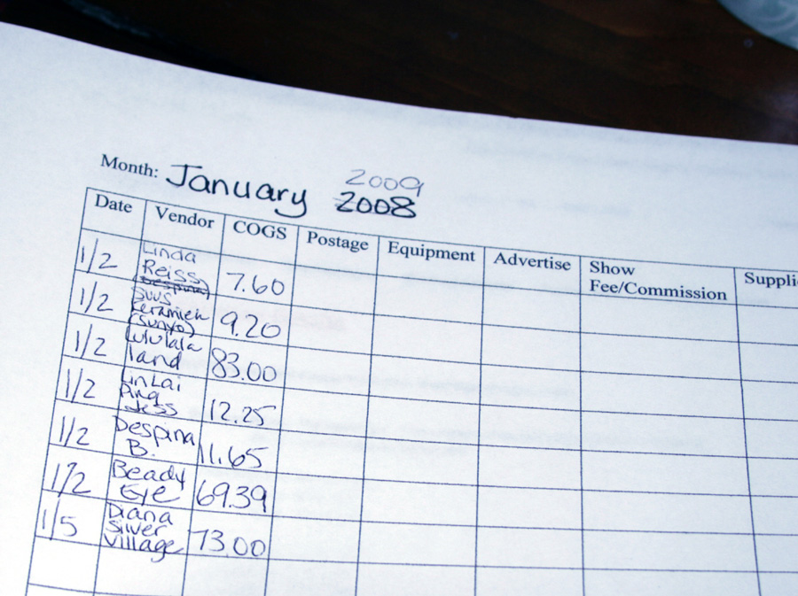
Keep data collection and reporting as simple as possible, but be specific.

Slide 16
5. Chart your progress.
Share pre-change (baseline)
and post-change data with:
Change Team
Executive Sponsor
Others in the organization
Use visual aids for sharing data.
Line graph
Notes:
.

Slide 17
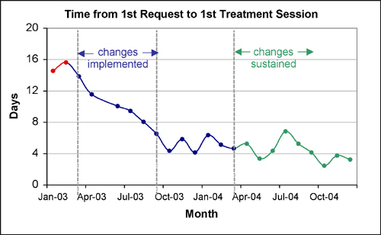
A simple line graph example
Remember: One graph, one message.

Slide 18
6. Ask questions.
What is the information telling me about change in my organization?
Why was one change successful and another unsuccessful?
Always ask why.

