Slide 1
Flowcharting
Tab 5
Flowcharts force an organization to focus on a process.

Slide 2
Flowcharting Objectives
Understanding what a flow chart is
Practice flowcharting

Slide 3
Flowcharting is useful for:
Understanding the process as it actually is (& documenting the process)
Providing a starting point/baseline view
Identifying key problems/bottlenecks
Showing where to test ideas for most impact
Adding interactivity & fun - gets the team together
Creating a simple & succinct visual process overview

Slide 4
Key Questions for Flowcharts
• Is the name of process clear?
• Where does the process begin?
• Where does the process end?
• What does the process include/not include?

Slide 5
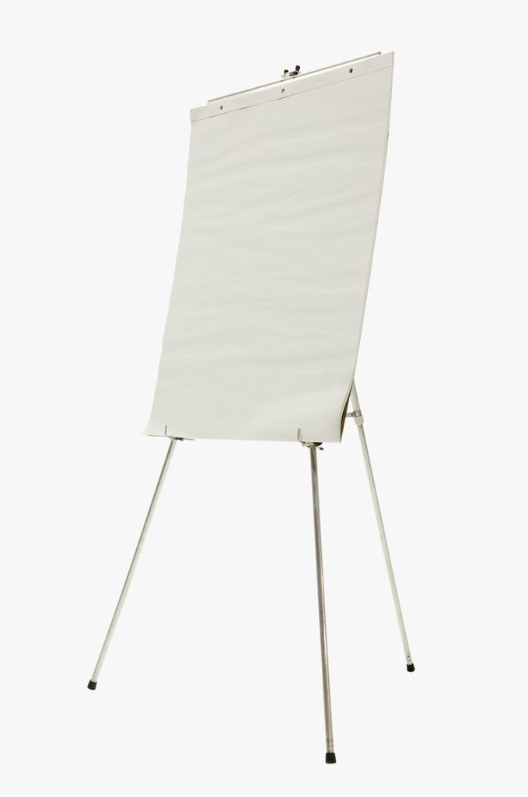
Setting up a flowchart
Customer’s 1st phone
call requesting a service.
START
Customer
calls
office
1st Appointment is scheduled
.
END

Slide 6
Key Symbols for Flowcharts
Post-It Notes are great for flowcharting.
Action
A square identifies a step in the process
?
Yes
A diamond is a decision point in the process and asks a “yes or no” question.
No

Slide 7
Sample Flowchart
Process name: Customer 1st Contact (phone call) to Agency Response
START
1 person to answer phone
Receptionist
answers
phone?
Receptionist
able to help
customer?
Customer
phones agency
Yes
Yes
Receptionist “thanks” customer
Website
No
No
Walk-in
Customer routed to voicemail
Transfer customer to qualified staff person
Hang up phone
Referral
Other 1st Contact Options
Checked 1x per day
Staff not available
END

Slide 8
Group Flowcharting
For more information go to http://www.niatx.net/PDF/PIToolbox/Flowcharting.pdf

Slide 9
Group Flowcharting
To gain different perspectives and mutual understanding

