Slide 1
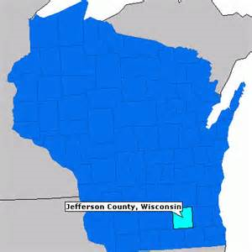
Jefferson County Human Services
Improving outcomes
through Crisis intervention
and stabilization services
Niatx project
October, 2015

Slide 2
Jefferson County Human Services Department
JCHSD recognized in 2013 that too many youth were being admitted to Winnebago Mental Health institute.
We formed a change team, comprised of all mental health and child and family supervisors, managers and our director.
We have met monthly since 2013. this is the story of the youth we serve and our change initiatives.

Slide 3
JCHSD YOUTH EMERGENCY DETENTIONS AND COSTS
2013-2015
 | 2013 | 2014 | 2015
E.D.’S | 33 | 18 | 12 ?
COSTS | $134,584 | $70,393

Slide 4
PLAN, AIM AND RATIONALE
Decrease the number of hospitalizations of youth
Increase access to community mental health services

Slide 5
ADAPTED
We have taken the following actions to develop the needed interventions:
Our internal team meets monthly, to review data and situations we have encountered.
We revamped our Crisis Plan and trained all staff in how to do a more detailed version.
We gave awards and recognition for “well done” Crisis Plans.

Slide 6
ADAPTED
We asked our community partners about who are youth in need.
We hired a Youth Therapist in our Mental Health Outpatient Clinic area.
We contracted with additional hospitals for inpatient psychiatric services.
We contracted for additional outpatient therapy services.

Slide 7
ADAPTED
We are participating in the DCF Family Trauma Informed Care and in the Department of Health Services Project Yes grants.
We added positions in our Comprehensive Community Services program and are serving more youth.
We are serving more youth in our Community support Program.
We wrote a purpose statement for our meetings.

Slide 8
LESSONS LEARNED
Set aside the money issue and remember your mission
Involve people with lived experience
Review data routinely
Meet regularly and have a champion
Know what works: evidence based practices, motivational interviewing and compliance program
Provide staff with autonomy, training, and recognition
persist

