Slide 1
Quality Crisis Plans, All on Time WRIC Community Support Program (CSP), La Crosse location

Slide 2
Project Aims
Big AIM: Decrease our county psychiatric hospital readmission rate
Small AIM- For our CSP Crisis Plans to be of a quality that assists in crisis management, and completed on time (and submitted to our county partner/mobile crisis provider) on time. Our CSP provides phone crisis services 24/7 but the county provides mobile crisis services, so it is important they have accurate and timely information, to best help consumers manage crises and stay out of the hospital
Baseline: 26 of 108 Crisis Plans were overdue (24% of them)
Target: 0 of 108 Crisis Plans overdue

Slide 3
Changes
Intervention- Split large staff team in to two teams
Consult with County about Process Issues- Do not need signatures when send
Walk Through Crisis Plan Process with Staff
Change in Process #1- who takes/sends plans to county
Consult with County about Quality of Plans
Intervention- Checking plans weekly
Intervention- Incentives offered
Intervention change- Changed day of week check plans so that can add reminder of plans due for upcoming week
Intervention- Reduce Clinical Coordinators Case Load
Intervention- Connect Crisis Plan Completion with Recovery Plan Completion and Begin Team Oriented Recovery Plan Meetings with Consumers
Intervention- Re-training in EHR, so that alerts in EHR workflow more effective
Intervention- Measure What Helped- per Staff

Slide 4
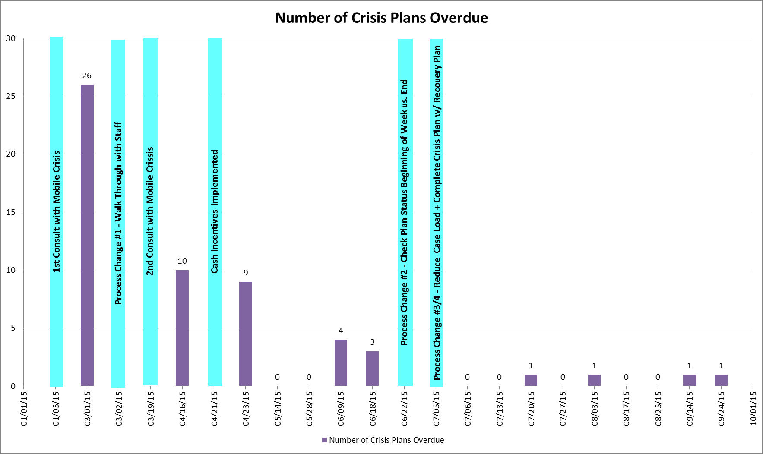
Project Timeline + Results

Slide 5
Next Steps
How do we keep our gains?
Continue monitoring in a planned way, on a systemic level
Use methods staff report were helpful
Set specific results to staff of overdue work
Has this impacted clients?
Use of hospitalization/out of home stay data

Slide 6
Impact
This has benefitted our program, first because we have nearly eliminated the problem of late Crisis Plans. Our referral source and partner agency in crisis management of CSP consumers reports this was a problem that “kept my staff up at night. That’s no longer occurring”. Second, because we’ve used the strategies that worked in improving timely Crisis Plan completion to other need areas, such as Functional Screen, Admission Paperwork, med consents and Progress Notes completion. Staff feel included in the process and proud of their achievements. There is the hope that better crisis planning and coordination between crisis management agencies leads to better crisis management and reduced psychiatric hospital readmissions.

Slide 7
FCC at a Glance
Serves children, families and individuals with a continuum of services designed to strengthen families and promote individual well-being.
Provides a continuum of innovative programming that responds to and meets the changing needs of the communities we serve.
Services range from prevention programs, like Healthy Families, to intervention programs like outpatient counseling, alternative education and day treatment, to out of home care options, like treatment foster care, youth home, residential treatment, and an adult group home.

Slide 8
Questions?
For more information, contact
Kathy Rohr
Family & Children’s Center
(608) 785-0001 x287
krohr@fccnetwork.org
www.fcconline.org

