Slide 1
Wisconsin River CCS Collaborative
Our three counties (Columbia, Sauk, Richland) applied and received state approval to work together as a CCS Regional Service Model in July, 2014. Each county has an individual certified CCS (Comprehensive Community Services) program and has been providing services. Regional models must increase access to CCS services while maintaining existing quality and efficiency of program services AND develop a means to evaluate outcomes that reflect the joint efforts of the cooperating counties!
Wisconsin River
CCS Collaborative

Slide 2
Our 2015 BIG Aim: Identify/increase number of treatment providers to deliver services to CCS consumers in all 3 counties and create an efficient process for certification, contracting and rates.
Wisconsin River
CCS Collaborative

Slide 3
Our Small Aim: Continue the development of our Wisconsin River CCS website to 1) increase the available number of CCS vendors throughout our three county region and 2) identify the diversity of staff/services available within vendors.
Website at http://wisconsinriverccs.org

Slide 4
Steps for 2014-2015:
Phase 1
Inform existing vendors (sent letter) of the website and our action to post their agency name and contact number.
Staff from our 3 counties worked together to design the format of site portal (FileZilla) to store and organize all vendor information.
Phase 2
Vendor information from each county sent to Columbia County (Rona) to load into portal. Spreadsheet created to track DQA requirements for vendors to maintain their CCS certification.
Phase 3
Phase 4
Identify software and open “application portal” on website so new vendors can apply and submit information directly to WI River CCS website.

Slide 5
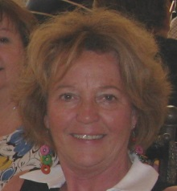
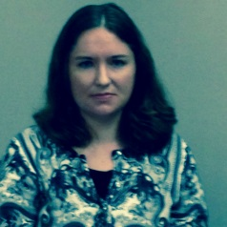
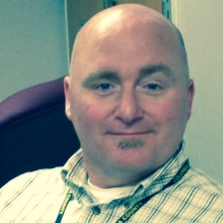
NIATX for 2015:
What we will measure:
The number of existing vendors unique to the separate county partners (including the number of staff CCS certified and types of services that were provided) compared to 2014-2015 number of vendors that are CCS certified and listed on the website (NOW available to the regionalized partner programs of the three counties).
Change Team Members are identified as Sharon Boesl, Sauk County, Shannon Robinson, Columbia County, and Miranda Culver, Richland County.
.

Slide 6
Building WI River CCS Network

Slide 7
Summary
Our 2016 joint efforts continue…Next, we will tackle how to create a Regional Coordinating Committee which will be instrumental in the expansion of services to all three counties!
The Wisconsin River CCS Collaborative has shown that working together as a region created expansion of the provision of CCS services to consumers across Columbia, Richland and Sauk Counties.
Wisconsin River CCS Collaborative
Expansion of Consumer Services Across Region.
Shared Provider Credentialing
Shared Provider Training
Shared Web-Site
Regional Coordinating Committee

Slide 8
Questions? WANT More Information?
Visit the WI River Collaborative website
(created by Richland County MIS staff)
www.wisconsinriverCCS.org
Feel free to contact us with further questions:
Shannon.Robinson@co.columbia.wi.us
Myranda.Culver@co.richland.wi.us
Sboesl@co.sauk.wi.us

