Slide 1
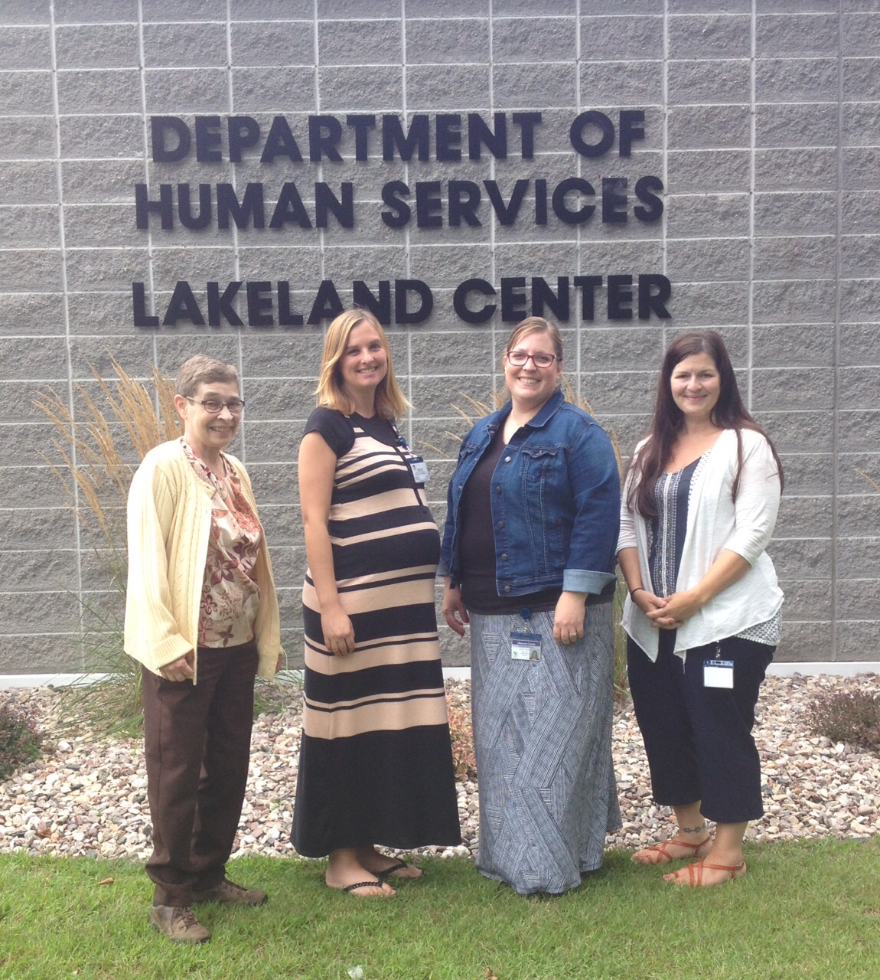
Shawano County DHS 2015 NIATx Project
Executive Sponsor: Kelly Bueschel
Change Leader: Jessica Delzer
Team Members: Jane Coleman Jennifer Frost

Slide 2
AIM
Big AIM: Decrease county readmission rate.
Small AIM: Engage 10 adolescent female consumers in a DBT (Dialectical Behavior Therapy) group model, teaching specific skills, to decrease contacts with crisis, law enforcement, and subsequent inpatient hospitalizations.
Expected impact: Decrease in readmissions of this population, which has been on the rise since late 2013.

Slide 3
Adolescent Dialectical Behavior therapy group
16 weeks
1 hour per week
Co-facilitated by two therapists
Focused on building new skill each week
Skills include, but not limited to:
Mindfulness
Crisis Survival Skills
Managing Really Difficult Emotions
Reality Acceptance Skills
Emotional Regulation

Slide 4
Surveys and readmission data

Slide 5
Lessons Learned
Importance of pre-treatment: Identifying and solidifying the commitment needed to participate in a 4 month long group.
Significance of prior relationships between members and the impact of a small community: More concrete dialogue regarding appropriate group behavior, both in and out of group.
Need to reinforce the skills learned in group in weekly therapy sessions.
Structure and teaching methods were adjusted/modified as group progressed from the format previously used in the adult DBT group to engage teen members.

Slide 6
Next Steps
Train 4 additional staff in Fall 2015 to provide DBT in both individual and group modalities.
Structure treatment to more cohesively combine both the group therapy and individual therapy, such that each group member utilizes individual therapy on a weekly or bi-weekly basis to support skills learned in group, and to process through what occurred in group.
Better screening/matching of group members with regard to age and peer group.
Ensure parent/guardian of each consumer truly understands the group process and skill development.

