Slide 1
Faster Access to Aftercare
Wood County Human Services
Outpatient Behavioral Health Clinic and Norwood Health Center
Wisconsin Rapids and Marshfield, WI
Stephanie Gudmunsen, Elizabeth Masanz, Karen Brewer, Susan Schuler-Sheveland, Kristi Smith, Stephany Andres, Deb Foth, William England, Pam Martinson, Heather Grys-Luecht

Slide 2
What are we trying to accomplish?
1. Increase the number of clients that have follow-up appointments scheduled in an outpatient setting within 7 days post discharge from the inpatient psychiatric unit at Norwood Health Center, from an unknown baseline percentage to 100%.
2. Decrease the average number days a client needing follow-up care waits to see a provider (LCSW, LPC, MD, PsyD/PhD) in the outpatient setting of Wood County Human Services, post discharge from Norwood, from 30 days to 7 days or less.
3. Increase the number of clients attending the first scheduled follow-up care appointment with WCHSD, after discharge from NHC from 50% to 75%; with follow-up contact on 100% of clients that no-show for the first appointment.

Slide 3
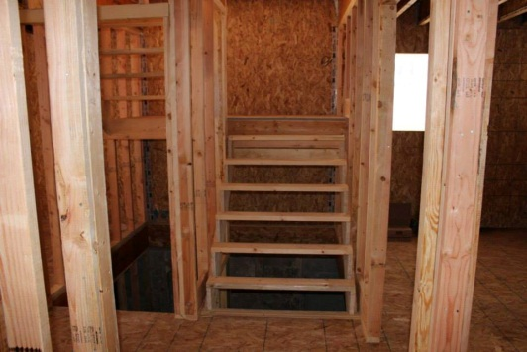
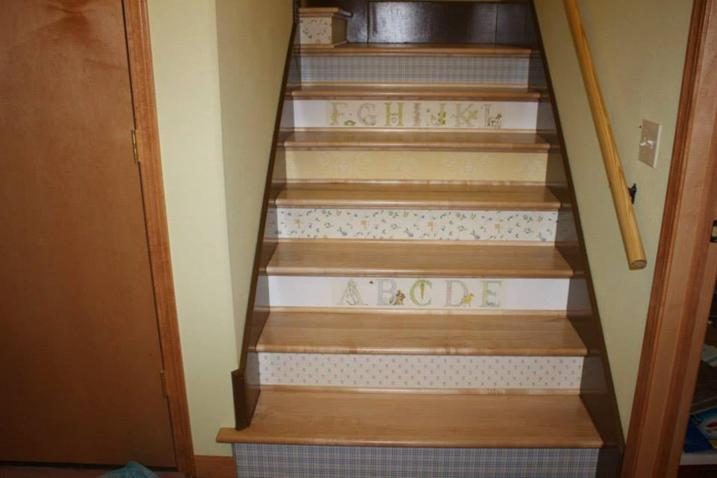
Steps taken… Changes considered
Post discharge phone call within 24-hours
Time was not protected for staff making calls, so this does not always happen
Create communication flow with clinic – schedule the “walk-in” slot vs telling client to go to walk-in clinic
Clinic staff not aware to expect patient, therefore no follow-up for no-shows
Discontinue Outpatient Clinic Mental-Health Walk-In Clinic
Dedicate these two weekly, Wed AM slots to NHC discharges
Dedicate two weekly appts the following week from therapist covering walk-in clinic
Fast track certain clients to skip intake with therapist and see MD directly in certain circumstances
Schedulers to notify social workers if NHC follow-up attend appt or not; SW to follow up with no-shows

Slide 4
How does your project grow?
Target Population:
Clients discharging from inpatient and seeking aftercare at Wood County for the first time
Some of this project work started before formally collecting data
Gathered baseline from mid March through mid July 2015
Target population numbers significantly declined mid July through September – based on limited numbers, no accurate assessment of trends can be made, but rates for all metrics appear to be holding
Metric 3 - 100% follow-up on no-shows has not yet been achieved

Slide 5
What’s next?
Continue to gather data
Ongoing evaluation of readmission rates and related indirect metrics
Put processes in writing to ensure agreement and consistency
Continue to evaluate processes to identify gaps and opportunities for improvement

Slide 6
The project to-date Is it good business?
We think so, but don’t really have the data to prove it
Focused target populations can be easier to work with, but if something changes and data becomes limited, it can be difficult to know if changes are really meaningful
Communication is key
Memories are short, which makes written policies and procedures important

