Slide 1
NIATx Change Projects 2011
Community Recovery Works
Jefferson County Human Services
Community Support Program

Slide 2
THE AIMS
Reduce Hospital Admissions by one per month for a six month period. (20%)
Standardize the admission process to our emergency stabilization beds, Lueder Haus.

Slide 3
The Change
1. Develop and implement a standard admission process to the Lueder Haus.
2. Ensure that all treatment goals for the Lueder Haus are specific and measurable.

Slide 4
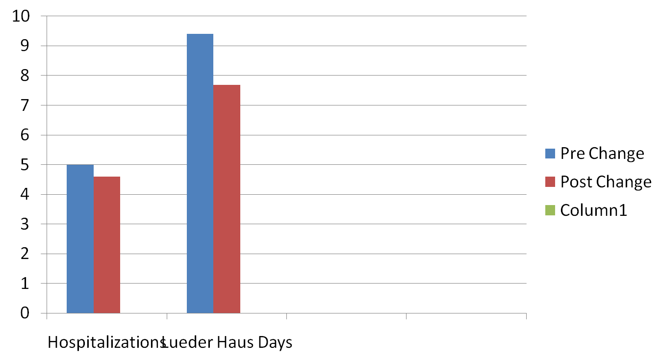
The Results

Slide 5
Action
Adopted both changes
Will implement changes across the agency
Will focus on recent readmission based of premature releases from hospitals

Slide 6
The Impact
Improved communication between LH and CSP staff
Improved services at the LH
More treatment in a less restrictive setting
Closer follow up during LH stay

