Slide 1
NIATx/State of WI
Mental Health Collaborative
Reduce Waiting & No-Shows • Increase Admissions & Continuation

Slide 2
Background
Big Aim…
Reduce hospital readmissions

Slide 3
Areas to Improve:
Front-door
Treatment
Back-door (& beyond)

Slide 4
Next Steps:
Continue what you have started
Sustain
New aim?

Slide 5
Let The Presentations Begin!

Slide 6
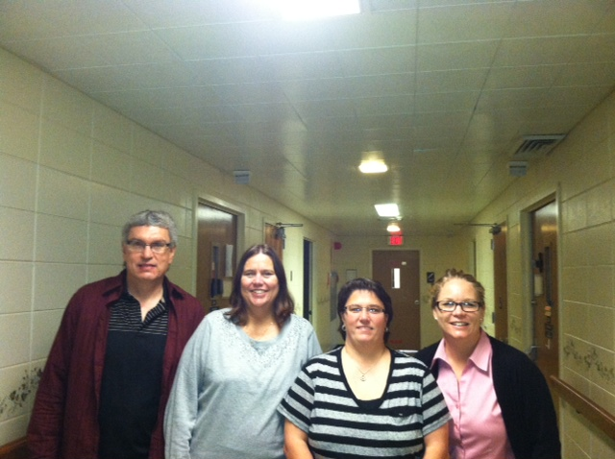
Rock Stars
Improving service to
clients by decreasing
length of time from
intake to connection
with a provider

Slide 7
Project Aim
Decrease length of time between request for services and entry into treatment to no greater than 2 weeks.
Specific Population: Clients admitted to Residential Crisis Stabilization following a hospitalization or other mental health crisis

Slide 8
Changes
1. Added 4 hours/week of additional time for intake/assessments
2. Changed protocol to perform assessments on site at Stabilization facility prior to discharge vs. after discharge at the outpatient clinic.

Slide 9
Results

Slide 10
Results

Slide 11
Adopt Adapt Abandon
Adopt increased staff time dedicated to Assessments
Adopt on site assessments at Stabilization Facility
NEXT: improve scheduling processes to decrease length of time to enter outpatient schedules
NEXT: expand mobile assessments to include sites other than crisis stabilization facility

Slide 12
Impact
37% decrease in length of time between assessment and entry into care
Earlier and improved engagement and customer service by providing on site assessments
Improved satisfaction of Crisis Stabilization staff with more solid discharge plan in place

