Slide 1
Reduce Re-Admission Rates
Winnebago County
Niatx Project
2013

Slide 2
The Change Team
Doug Brey
Crisis Intervention Supervisor
Melissa Hoodie & Jim Travis
CCS/CSP Supervisors
John Sheehan
CBRF Coordinator
at Summit House and Toward Tomorrow

Slide 3
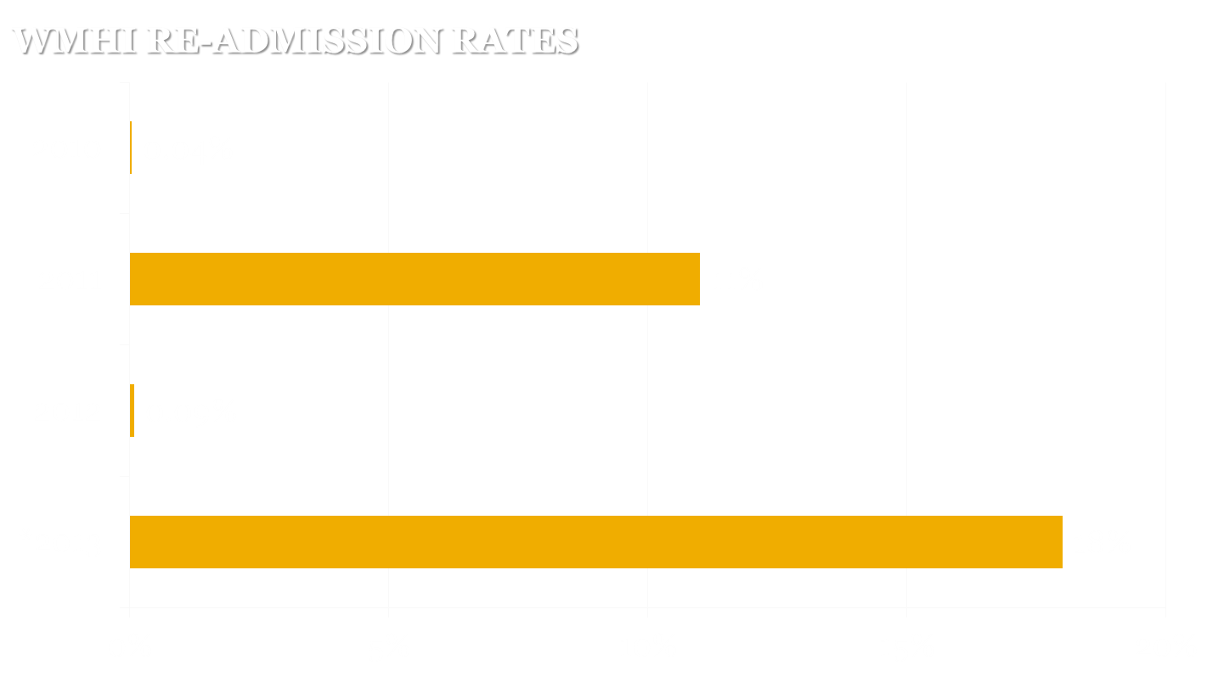
The Numbers
Average for 2010-2013* is .08%
*2013 (thru 6/30/13) is .09%
Extrapolation based on 2013 data is 18 %

Slide 4
The Purpose
BIG AIM
Eliminate 30-Day Re-Admissions
little aim
decrease re-admission rate to 1% or less

Slide 5
The Change
Clients at risk for re-admission will be placed in a crisis bed upon d/c
Clients will be seen by a psychiatrist within 24 hours of acute sx increase
Case management staff will see their clients
at least 2 times/week when clients are in a
crisis bed
Crisis Center Director will attend CCS/CSP
morning meetings as needed

Slide 6
The Results
Not great, but improved
Two clients have been seen on emergency basis (JS, DR) after some serious lobbying with the psychiatrist. Neither re-admitted.
CCS/CSP staff assisting w/1:1 staffing
at crisis center
Development of protocol for clients to
get emergency med review on outpatient
basis

Slide 7
The Next Steps
Develop and disseminate protocol of treatment expectations for case managers by December 1st 2013
Brain storm ways to get prescribers on-board with paradigm shift
Track discharges & do follow-ups with clients
who are returning home after any inpatient
treatment who have a history of
re-admission

