Slide 1
Mental Health collaborative Project
Wood County Human Services Department
Presented by Randall Ambrosius, MSW, LCSW, CSAC, CSIT

Slide 2
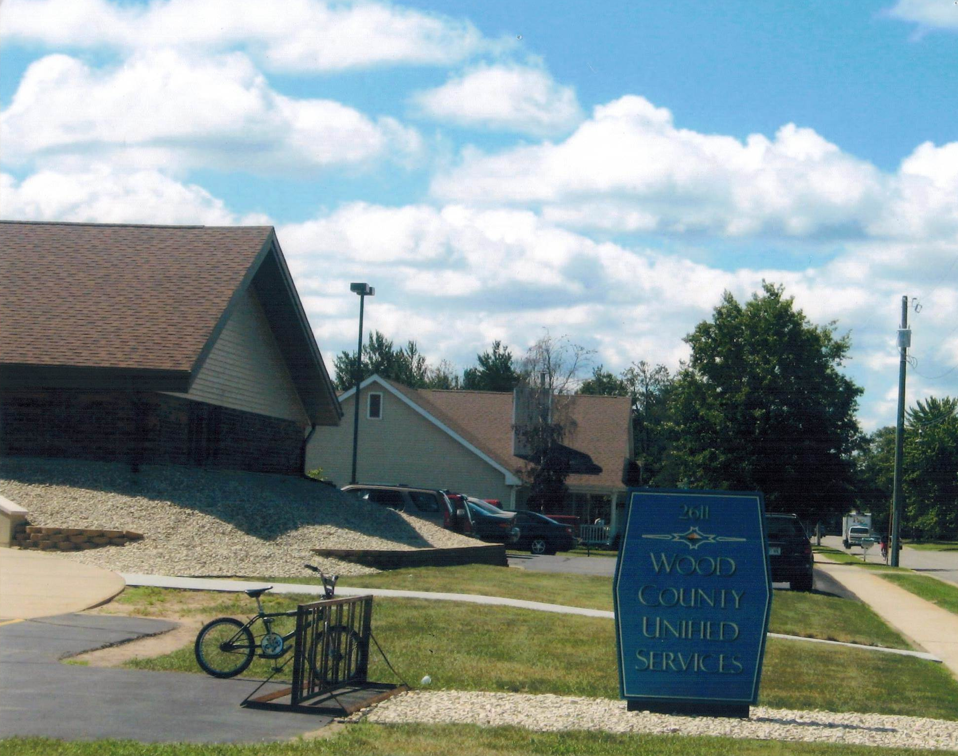
Wood county
For more info . . .
http://www.co.wood.wi.us/

Slide 3
Change Leader and Team Members
Randall Ambrosius- Change Leader and Treatment Services Manager
Pam Martinson- Health Information Manager
Janelle Prince- MSW Grad Student Intern
Kristi Smith- Client Services Manager
Jessica Merkel- CCS/CSP Manager

Slide 4
Project Goals
Make support calls to clients that have been recently discharged from Norwood Health Care Center
Data is collected and evaluated for patterns and reasons for rehospitalization
Decrease readmission rate to Norwood Health Care Center to 10% or less

Slide 5
May- August
Prior to this project, the average readmission rate to Norwood was 15%.

Slide 6
Before
Med.
Management
Client
Discharged
Therapy

Slide 7
Staffing Process
Norwood Inpatient
Staffing
(started in June)
Services

Slide 8
After Staffing
Day
Treatment
Oxford House
Psych Services
With Dr. Andrews
Client
Discharged
Med.
Management
Drug Court
CBRF
Therapy
CCS

Slide 9
Results of this Project
By staffing, we learn about more resources in the community.
We have more effective communication among resources.
Clients are more optimistic about their recovery.
Still learning how more resources are affecting clients. Project is ongoing.

