Slide 1
NIATx PROJECT Reduce Re-Admission Rates
Winnebago County
2014

Slide 2
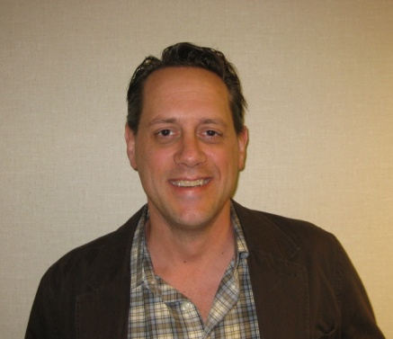
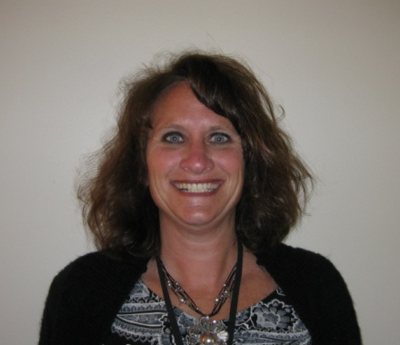
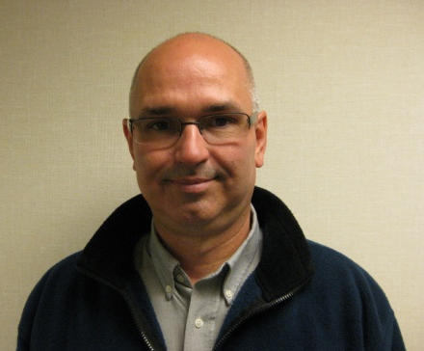
The Change Team
Doug Brey
Crisis Intervention Supervisor
Melissa Hoodie
CCS/CSP Supervisor
John Sheehan
CBRF Coordinator
Summit House & Toward Tomorrow

Slide 3
The Numbers

Slide 4
The Purpose
BIG AIM
Eliminate 30-Day Re-Admissions TO ALL FACILITIES
little aim
quicker community based services

Slide 5
The Change
Clients at risk for re-admission will be placed in a crisis bed upon d/c
Case managers will attend weekly meetings with crisis team
Case management staff will see their
clients at least 2 times/week when
clients are in a crisis bed
Crisis Center Director will attend
CCS/CSP morning meetings as needed
Intensive and extended assessment

Slide 6
The Results
In 2013, two clients were seen on emergency basis (JS, DR) after some serious lobbying with the psychiatrist. Neither were re-admitted.
In 2014, seven clients were seen for crisis case management
CCS/CSP staff were assisting 1:1
at crisis center
Only one person re-admitted

Slide 7
The Next Steps
Continue Crisis Case management services
Create a Crisis Case Manager position by shifting staff from CCS or CSP
Add Peer Support Specialist position
Collaboration with Peer Run Respite Center

