Slide 1
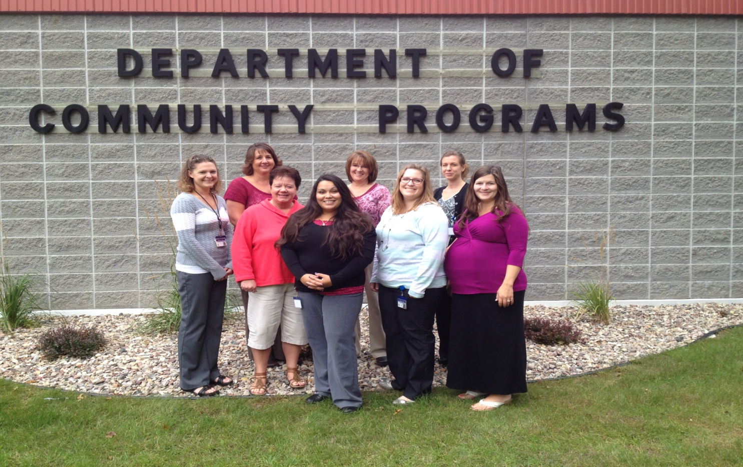
SHAWANO COUNTY DCP: 2014 NIATx CHANGE PROJECT
Team Members: Olivia Rosenow, Jessica Delzer, Kelly Bueschel, Jennifer Jacobson, Jan Rosenheim, Tracy Van Ert, Sharon Luepke, Joy Artis

Slide 2
The Aim
Decrease our county readmission rates
Increase engagement/satisfaction/ retention in services to prevent disengagement and subsequent crisis situations

Slide 3
Surveys/Re-admits
Volume of Surveys Returned
Readmission data, comparing consecutive years (5/22-10/4)

Slide 4
Engagement/ Satisfaction/ Retention in Services, Comparing Years (08/13 vs. 08/14)

Slide 5
Results
√ Engagement in services increased by 8.2%
√ Satisfaction of services increased by 16.7%
√ Retention Increased by 97%
√ Volume of surveys returned increased from 3 to 120
√ Readmission rates remained low in past two years

Slide 6
A Path to Continued Success
Adopt project and continue to use survey methods established during this project to collect data
We will analyze survey data to identify program improvement and potential future change projects by program area

