Slide 1
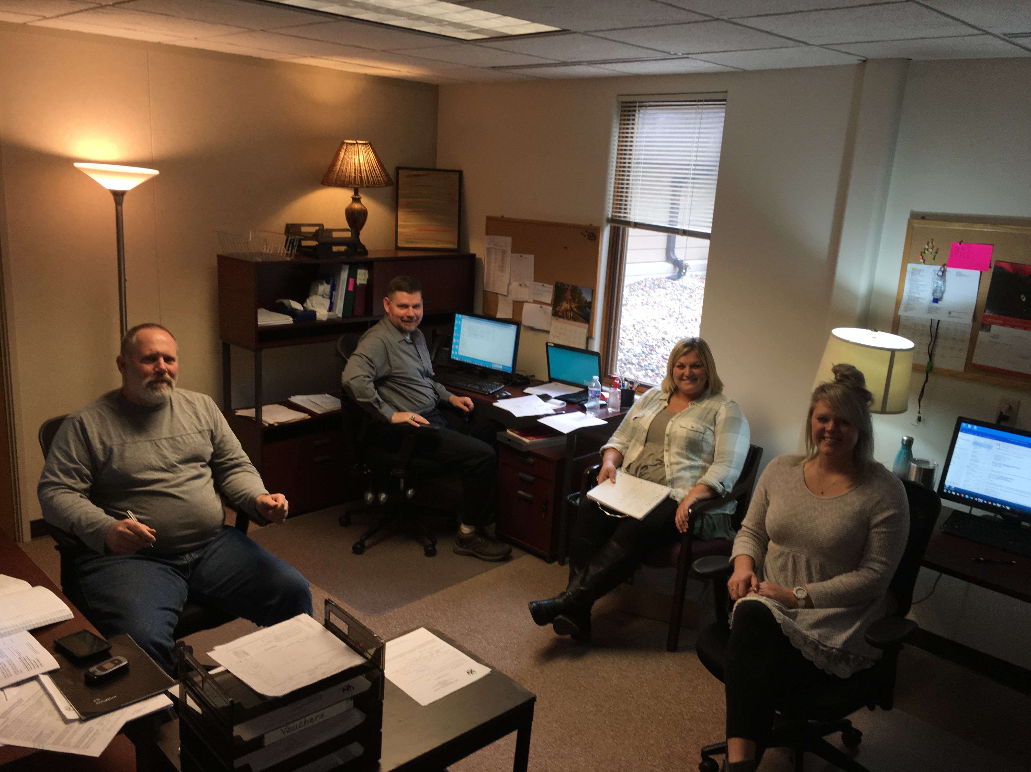
Emergency Services Program
FOV County HSC

Slide 2
History and Background
Crisis Response Program was a contracted service prior to 2016.
HSC Service Facilitators took initiative of developing and implementing best-practice guidelines to train screeners in-house November and December 2015.
HSC Service Facilitators took over the mobile crisis screening for Forest, Oneida and Vilas Counties in January 2016.
Mobile crisis response team is a coordinated effort encompassing the community, crisis line, law enforcement, screeners, hospitals, and county corporation counsels.

Slide 3
Role of Mobile Crisis Team
Increasing Screen Volume
Assess and Address Immediate Crisis.
Enhance the ability, understanding and resources of our community to deal with crisis through treatment and diversion.
Increase linkage and follow up to connect individuals and families with ongoing support, thereby reducing future incidents of crisis.
Reduce the high cost of unnecessary hospitalization on our counties.
Improve community health and wellness.

Slide 4
System Delivery Improvements
Linkage and Follow Up
Documentation
Improve Technology
Began providing linkage and follow-up to all persons screened by the crisis line.
Led to a bottleneck in our ability to provide services to clients in our regular programs beyond emergency services.
Developed a risk management tool to objectively assess need for linkage and follow-up activity.
Developed a more efficient tool for capturing client information and risk assessment.
Made changes to documentation style which led to an average decrease of 15 minutes/screen without reducing quality of content.
Reducing our time 15 min/screen with an average of 100 screens per month allowed us to spend an additional 25 hours per month serving our clients.
Phones:
Staff used personal phones
Staff exchanged 4 phones to use to respond to crisis calls
Staff each have their own work phone to respond for crisis calls
Remote Access:
New Laptops
Set up the One Drive
Microsoft Outlook
Sharepoint

Slide 5
Further System Delivery Improvements
Hired and Trained Additional Staff
Reduced Burden on Current Staff
New CSP Service Facilitator
New CCS Service Facilitator
New Emergency Services Facilitators (2)
New Emergency Services Coordinator
New Hospital Liaison
Increased contracted screeners to include 3 external screeners
Went from 7-12 after hours shifts per month in January to 2-3 after hours shifts per month by July.
Reduced time spent in ESP Supervision by non-dedicated ESP staff from 5+ hours per week down to just 1.
Staff Retention: We only lost one!

Slide 6
Results
Diversions & Dismissals
What does it mean?
An increase the amount of diversions from hospital stays by approximately 5% over the previous two years means that around 30 people were released with a safety plan rather then being detained in a hospital.
With the cost of an average 1-day stay in the hospital being $1,456, the increase in diversions saved our three-county board $43,680 over just six months!

