Slide 1
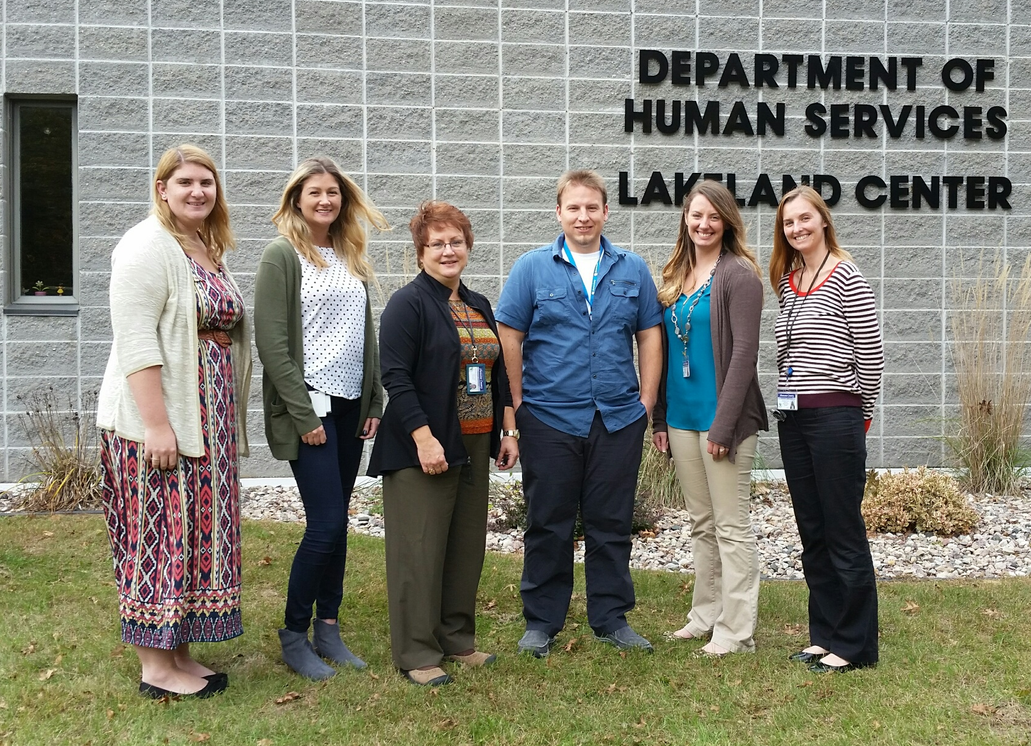
Shawano County DHS NIATx Project 2016
Executive Sponsor: Jen Frost
Change Leaders: Alicia Richardson & Greg Bartell
Team Members: Kaitlin Klitzke, Brenda Marquardt, and Kendra Brusewitz

Slide 2
OUR AIM
BIG AIM:
Decrease inpatient admission rate. Our average re-admission rate over the last 3 years is 24%; the average 30 day re-admission rate over the last 3 years is 5%
SMALL AIM:
Complete the mental health intake assessment and crisis plan within one week (7 business days) of discharge, 90% of the time, from April 1st to July 31st 2016, for individuals seeking aftercare services at DHS following an inpatient admission.
EXPECTED IMPACT:
Reduce the rate of no call/no show and cancelled outpatient appointments.
Increase commitment to services resulting in a reduction in our re-admission rate.

Slide 3
First week impact
Follow up to ensure linkage to services
Intake and crisis plan completed
within 7 business days
Intake and Crisis Plan appt. scheduled PRIOR to discharge
Inpatient Admission

Slide 4
Data
Only 1 readmission!
78%
MET OUR GOAL!

Slide 5
Lessons learned
Difficult to know the impact as the project entailed 2 separate projects being done at the same time (intake and crisis plan)
Revised crisis plan policy to reflect greater detail outlining criteria for drafting initial crisis plan
A minimum of weekly crisis follow up until after client has attended their 2nd outpatient appointment (intake therapist transfers to an ongoing therapist)

Slide 6
Next steps
For those determined to need a crisis plan, an appointment will be scheduled with crisis staff either before or after their intake to complete a crisis plan, in person, to build rapport between the client and crisis team.
Ensure clients have transportation to their intake during the scheduling/discharge planning process. Broaden resources available to Shawano Co. residents by networking with community partners and volunteer drivers to build upon services currently being offered. We hope this will increase utilization of crisis stabilization services/diversion beds.

