Slide 1
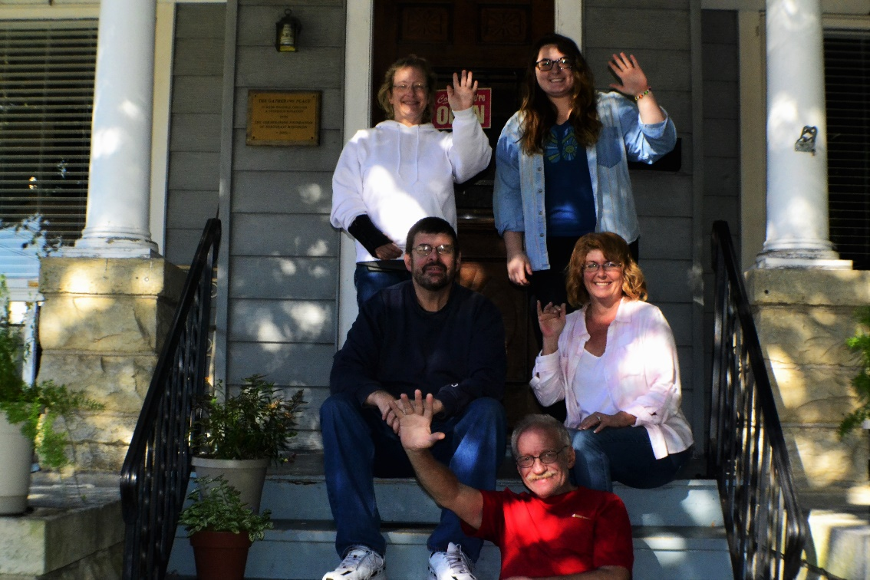
The Gathering Place
A 100% Peer Run Organization

Slide 2
Aims
Removing Barriers to Treatment & Recovery
Big Aim
To increase attendance and engagement at The Gathering Place which ultimately reduces hospitalizations.
We will use new membership forms to determine increase in attendance.
Small Aim
To increase attendance and effectiveness at support groups

Slide 3
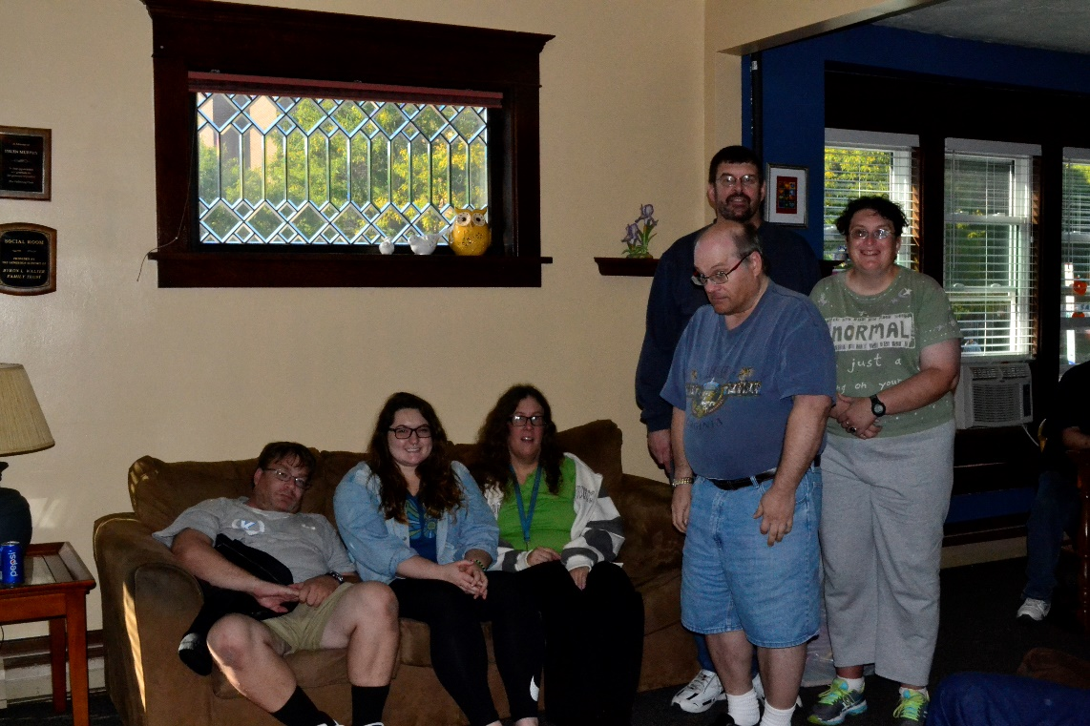
Changes
Walk through of facility
People came but did not stay…
Why?
Different Operation Policies & Procedures
Staff Trainings
Support Group Evaluations
Implementation of New Support Group
Hiring Certified Peer Specialists for Support
Monitoring Memberships

Slide 4
Next Steps
Carefully monitor on a regular basis
Walkthroughs
Keep statistical information
Improving Policies and Procedures
Implement more programs & groups as indicated by participants needs
Sustain Programs

Slide 5
Results
24 % increase in overall attendees coming to The Gathering Place.
Increase in overall member participation in support groups.

Slide 6
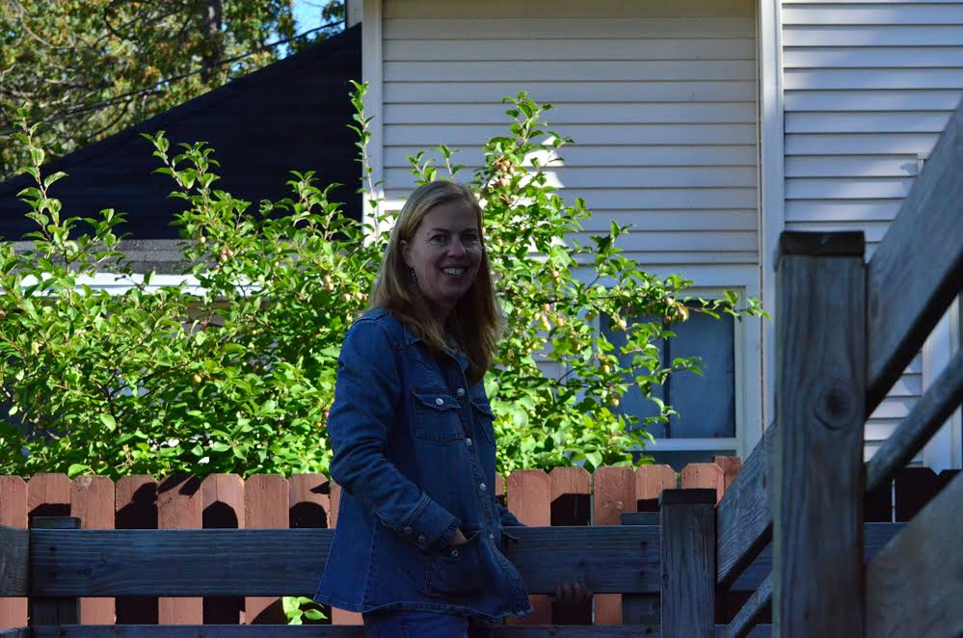
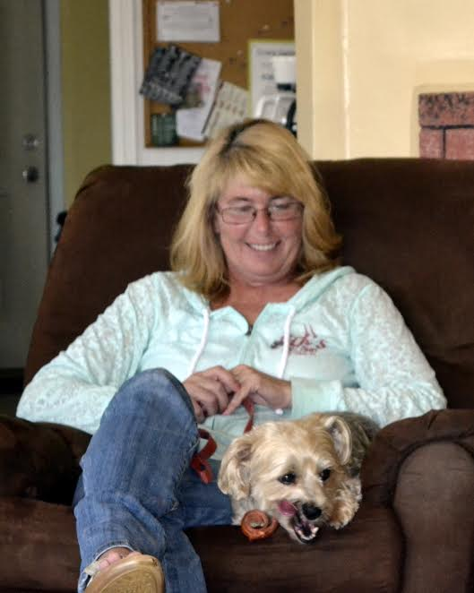
Impact
Always keep working towards making the gathering place a safe and healthy place for support
Can provide the best chance/opportunity for individuals to gather skills and support needed to maintain the personal wellness which in turn will help to reduce admissions to hospitalization
Keep vision on track

