Slide 1
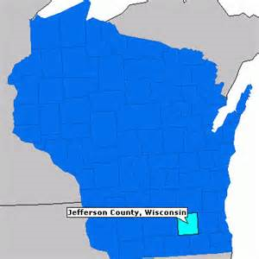
Jefferson County Human Services
Decreasing readmissions
Decreasing no shows
5X5
Mental health and substance abuse conference October 23rd, 2017
Cory krueger, MS, LPC-IT, SAC-IT, NCC
Outpatient clinic psychotherapist

Slide 2
Jefferson County Human Services (JCHSD) Outpatient Mental Health and AODA Clinic
The Outpatient Mental Health and AODA Clinic serves Jefferson County residents with mental health and substance abuse concerns.
The clinic staff consists of a Medical Director/Psychiatrist, A PART-TIME NURSE PRESCRIBER, 10 full-time staff with masters degrees in Social Work, Counseling or Psychology, one of whom works part-time in the county jail, as well as a Community Outreach Worker.

Slide 3
JCHSD Outpatient Clinic Numbers Served
2011-2016
 | 2011 | 2012 | 2013 | 2014 | 2015 | 2016
MH Clinic | 541 | 615 | 690 | 661 | 718 | 802
AODA Clinic | 225 | 288 | 334 | 327 | 393 | 406
Totals | 766 | 903 | 1,024 | 988 | 1,111 | 1,208

Slide 4
PLAN, AIM AND RATIONALE
Decrease no shows for initial assessments and on-going therapy sessions
Decrease overall no show rates by 15%
Rationale: ultimately decrease hospitalizations and increase revenue

Slide 5
HOW DO WE DO THIS?
NiaTx Team
Cory Krueger, Holly Pagel, Lori Zick, Krista Doerr, Amber Joyce, Lisa Dunham, Katie Melvin, Brandon Bykowski, Amanda Lightner
Brainstormed various ideas
Text messages, phone calls, automated system
Decided on reminder phone calls
Front desk staff, Lori Zick did reminder phone calls

Slide 6
CYCLES
baseline (no reminder phone calls): 5/8-6/7/17
Cycle 1 (reminder phone calls for group and individual sessions the day prior to the appointment: 6/12-7/10/17

Slide 7
No-Show Results
for individual appointments
Baseline (No-shows) = 20.2%
Cycle #1 = 14.7%
Post-Cycle #1 =16.5%
for assessments
Baseline (No-shows) = 36.2%
Cycle #1 = 15.7%
Post-cycle #1 = 57.1%

Slide 8
HOSPITAL READMISSION DATA
Baseline = 19.0%
Cycle #1 = 8.0%

Slide 9
ADOPTED ☺
Day | Monday | Tuesday | Wednesday | Thursday | Friday
Staff
Lori | Brandon Krista Lisa | Brandon Krista Lisa | Brandon Krista Lisa | Brandon Krista Lisa | Brandon Krista Lisa
Llana | Dave Amber Amanda | Dave Amber Amanda | Dave Amber Amanda | Dave Amber Amanda | Dave Amber Amanda
Tonya | Cory Katie | Cory Katie | Cory Katie | Cory Katie | Cory Katie
Bridget | Jennifer Heather | Jennifer Heather | Jennifer Heather | Jennifer Heather | Jennifer Heather

Slide 10
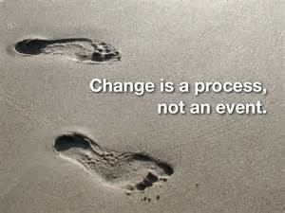
LESSONS LEARNED
No shows increased when reminder phone calls disappeared
Clients missed reminder phone calls
Need to monitor our readmission rate progress on an on-going basis

