Slide 1
TEAM CONNECT
NIATX CHANGE PROJECT 2017
Milwaukee County Behavioral Health Division

Slide 2
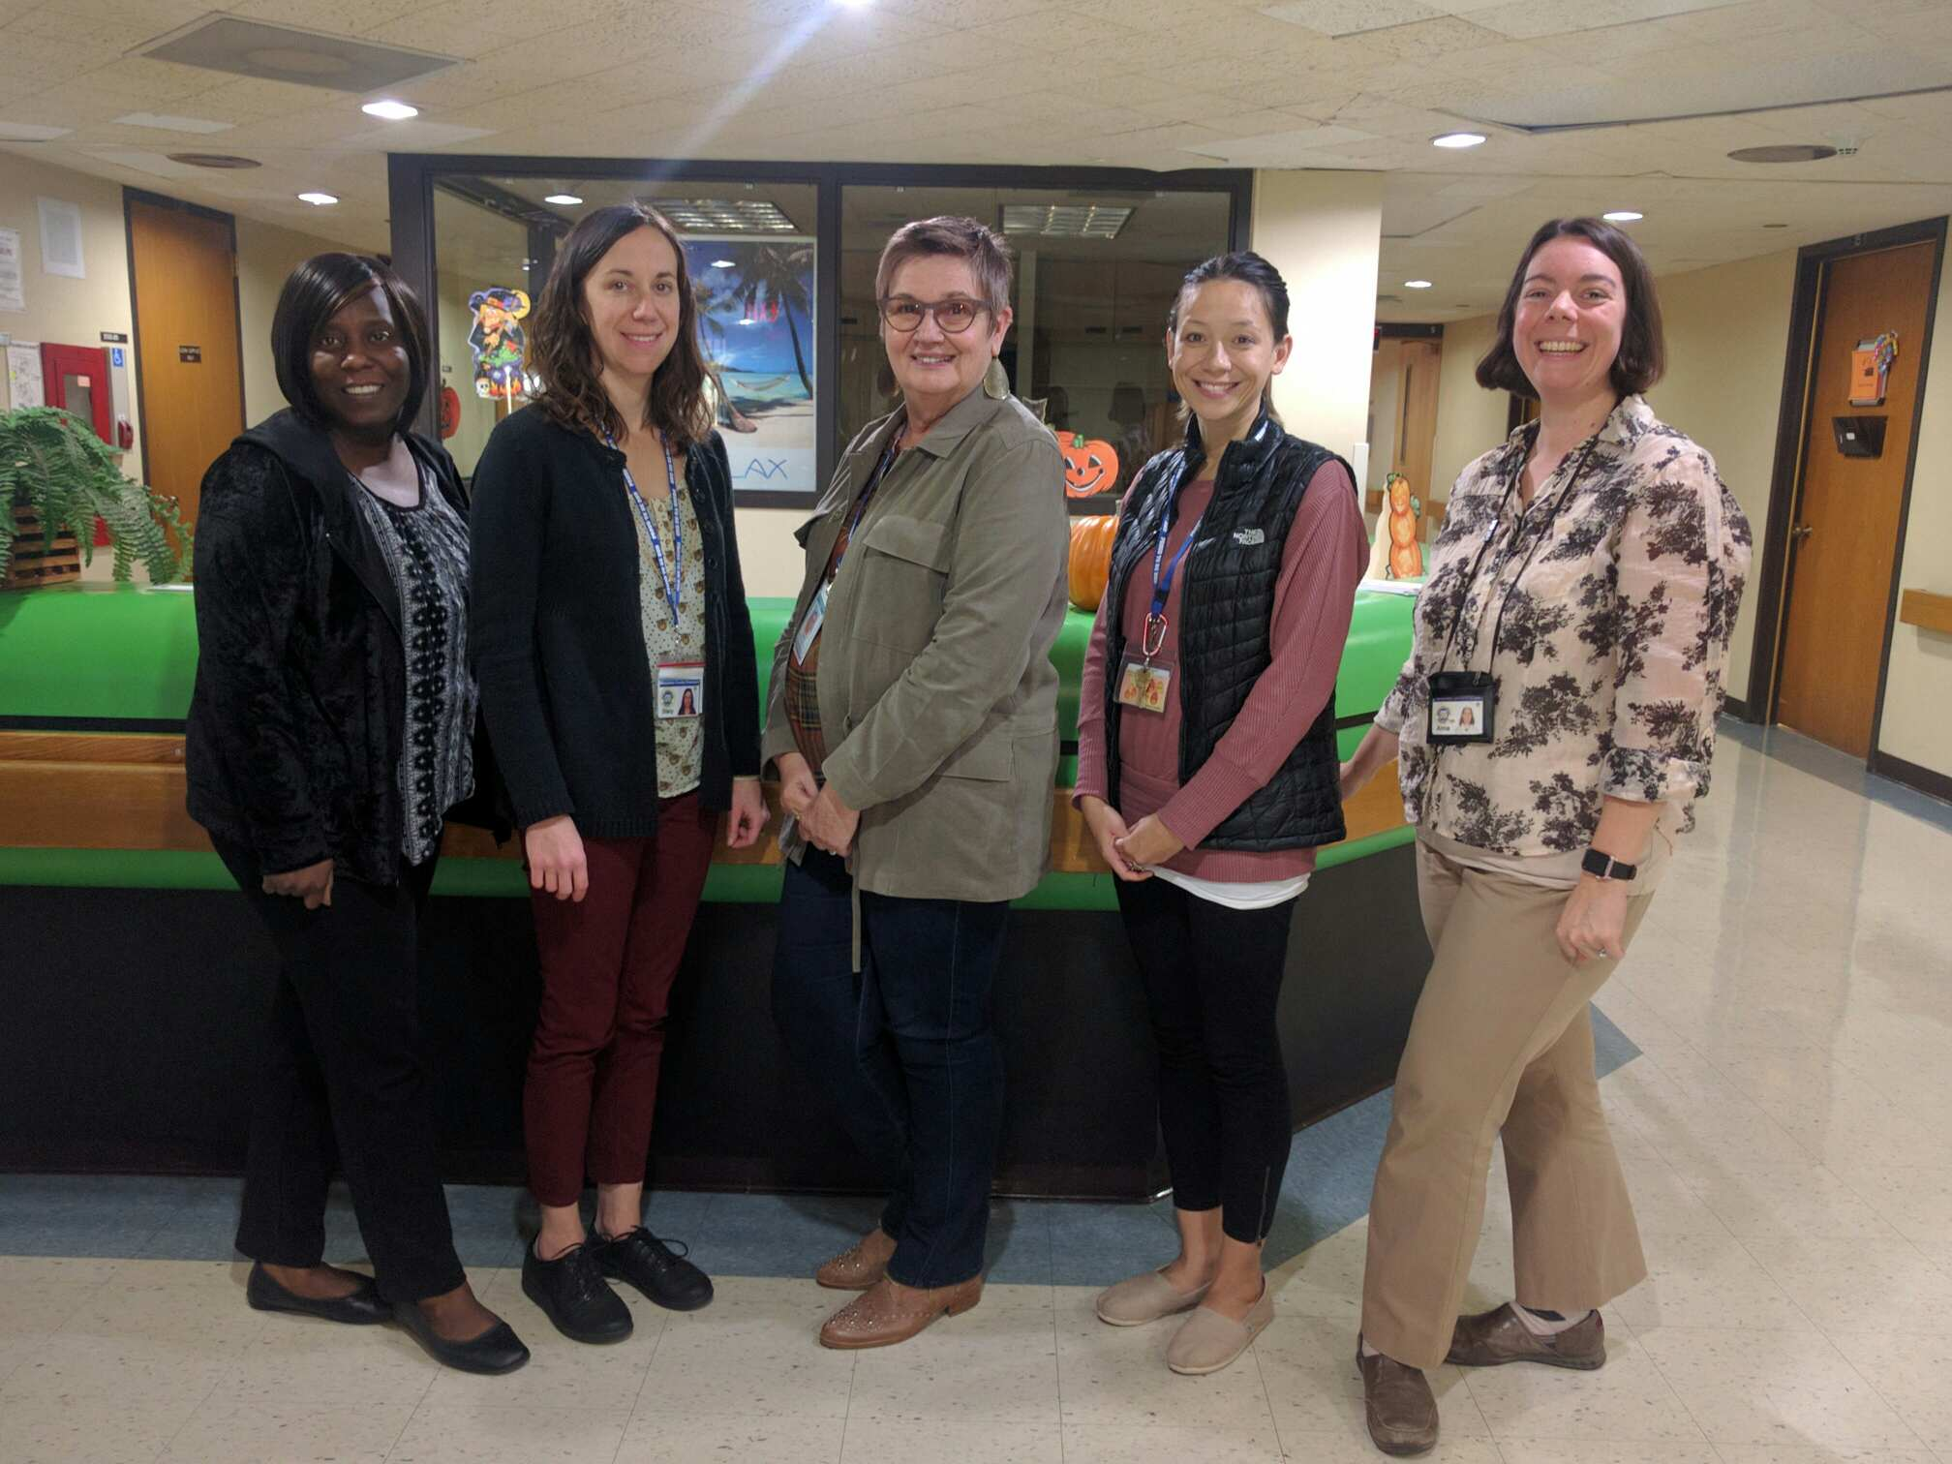

Slide 3
AIM
Big: Reduce the number of re-admissions to the Acute Adult Inpatient Service at the Milwaukee County BHD.
Little: Reduce the 30 day re-admission rate for the months of August and September 2017 by 25%, as compared to the average monthly 30 day re-admission rate from 2016.

Slide 4
CHANGE
TEAM CONNECT
Starting June 19, 2017, Team Connect staff will reach out by telephone, within 1 business day following discharge, to all individuals who are discharged from Acute Adult Inpatient units.
The goals of Team Connect are to:
Reduce the risk of harm to individuals post discharge
Help improve continuity of care
Ensure linkages to recovery focused supports
Reduce the incidence of hospital readmission
Team Connect staff includes: mental health clinicians and peer support specialists

Slide 5
RESULTS

Slide 6
NEXT STEPS
ADOPT, ADAPT, or ABANDON?
Adopt: Team connect will continue
Adapt: Informing individuals of Team Connect and building rapport before discharge from hospital
Adapt: Increase staff to allow more visits in the community by Team Connect

Slide 7
IMPACT
Improving communication throughout community programs and with natural supports
Enhancing discharge planning
Having a sole contact that individuals can go to with questions and concerns
Second and subsequent follow ups can be even more impactful
Improving communication within BHD

