Slide 1
Monroe County
NIATX Project: Hospital Readmission Reduction
Notes:
RON

Slide 2
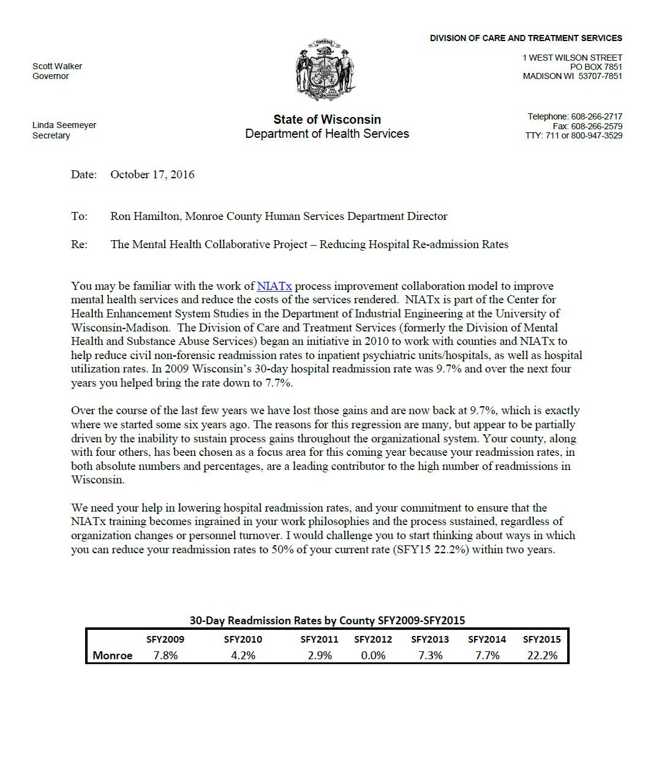
AIM
AIM: Reduce hospital readmissions by 50%
Notes:
RON
The State invited Monroe County to participate in a NIATx project because they saw that Monroe County had a very high hospital readmission rate.
We agreed that we wanted to address this issue, got our NIATx training, and established an AIM to reduce readmissions by 50%.

Slide 3
REVIEW OF DATA
22.2% seemed extremely high to us!
Did we have a problem we didn’t know about?
Just to be sure, Alicia and Shelly conducted an exhaustive review of EVERY hospitalization
Notes:
ALICIA & SHELLY
It surprised and concerned us that Monroe had such a high hospital readmission rate.
Did we have a problem that we didn’t know about? Something didn’t seem right.
We looked at the circumstances of every hosptialization in from the SFY 2015

Slide 4
CORRECTED DATA
We found that Monroe’s 30-Day Readmission Rate was actually 5%!
Notes:
ALICIA & SHELLY
After the detailed review, we found that many of the hospitalizations that the state identified as readmissions were not actually readmissions
After the review we discovered that Monroe’s readmission rate for SFY 2015 was actually only 5%
The discrepancy was due to how Monroe’s PPS data was uploading to the State
Even though we were able to determine that Monroe did not have a high rate of readmissions, we decided to go forward with trying to reduce this rate further

Slide 5
DECIDING WHERE TO START
MAIN REASON FOR READMISSIONS: person not connecting to services after discharge
DECIDED TO FOCUS ON DISCHARGE & FOLLOW-UP
Tabletop Walk-Through in lieu of actual Walk-Through to examine the discharge process and follow-up activities
Results of Review
Our follow-up has been conducted mostly with hospital staff (not client) during hospital stay
Difficulty contacting individuals following discharge
Notes:
NIKKI
Review of the readmission data revealed that re-hospitalizations mostly occurred due to person NOT connecting to services and going back into crisis after discharge
For this reason we felt that we needed our NIATx Project to focus on the discharge process
Tabletop “walk-through” identified that we don’t have direct contact with the person while he/she is in the hospital;
follow-up attempts did not occur until after person discharged
hospital shared contact information with follow-up staff
difficulty contacting individuals after discharge; individuals frequently did not respond to attempts to contact
so we could not assist with service linkage
Considerations:
IMPROVE ENGAGEMENT TO OUTPATIENT OR COMMUNITY SERVICES FOLLOWING DISCHARGE
Is service available and is person able to get appointments? Are there wait lists or other barriers?
Is person have what is needed to connect to services? Are transportation issues? Does person have insurance/funding needed for services? Are there other barriers?
Develop warm hand off with hospital at discharge.

Slide 6
CHANGE PLAN
IMPROVE ENGAGEMENT IN OUTPATIENT CARE
Develop a follow-up checklist of questions/topics to discuss with the person
Warm Hand-Off from Inpatient to the Community Service System
Connect with person while still in hospital to build rapport & establish a connection and troubleshoot barriers to service linkage
Participate in Hospital Discharge Meetings (In-Person for children)
Prior to discharge, schedule time to meet and develop a Crisis Plan
Notes:
NIKKI
IMPROVE ENGAGEMENT IN OUTPATIENT CARE with better FOLLOW-UP AND LINKAGE
Improve follow-up activities post hospitalization in order to better engage the person, increase the chance of them following through with services, and not require readmission.
Began Change Plan 6/8

Slide 7
1. CHANGE PROJECT TITLE | Monroe County Project to Reduce Hospital Readmissions
2. BIG AIM . | Reduce hospital readmissions by 50%.
3. What SMALL AIM will the Change Project address? Choose one aim that will help you achieve the Big Aim and indicate baseline measure and target. | WARM HAND-OFF: Improve follow-up activities post hospitalization in order to better engage the person, increase the chance of them following through with services, and not require readmission.
4. What POPULATION are you trying to help, e.g. participants in a specific program? | Individuals (adults & children) who are hospitalized and are either Monroe County residents or were hospitalized through the County crisis system.
5. EXECUTIVE SPONSOR | Ron Hamilton, Human Services Director
6. CHANGE LEADER | Tracy Thorsen, Human Services Clinical Administrator
7. CHANGE TEAM MEMBERS | Nikki Christensen, Sue Rettler, Alicia Darling, and Shelly Davis
8a. How will you COLLECT DATA to measure the impact of change on the BIG AIM? | Two systems of data collection will be used. All hospital admissions are recorded in a spreadsheet maintained by Human Services. PPS data will continue to be recorded with improved accuracy and will be reviewed as available.
8a. How will you COLLECT DATA to measure the impact of change on the SMALL AIM? | Follow-up activities that were conducted are also recorded on the same spreadsheet used to record hospital admissions.
9. What is the expected IMPACT of this change project? How will the Executive Sponsor know? | Improved connections with hospitalized individuals; Improved transitions into community treatment services; Reduced disruption to individuals lives
Notes:
TRACY
NIATx Charter Form

Slide 8
DATA COLLECTIONS
Use existing “Crisis-CH51 Tracking” spreadsheet
Record every Crisis Contact
Record voluntary & involuntary hospitalizations
Record first 3 Follow-up Contacts including if contact was with client in the hospital or in the community
Data
# of hospitalizations
# of readmissions
% follow-up contacts conducted while person in the hospital
Notes:
TRACY

Slide 9
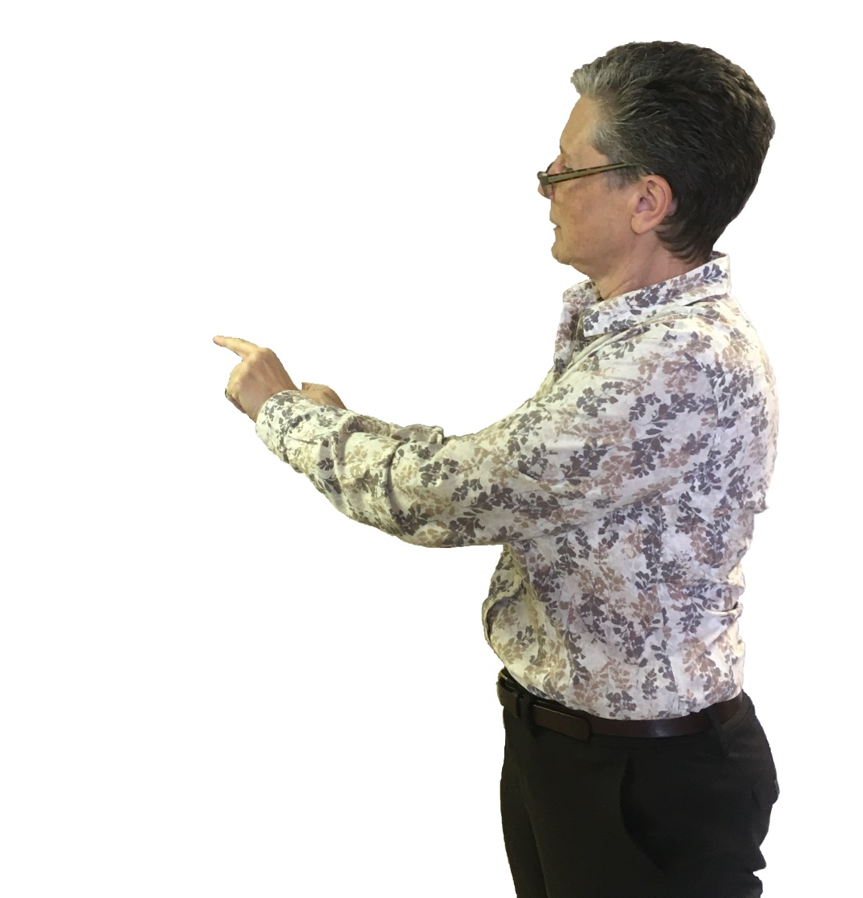
RESULTS
First Contact with Person in Hospital
First Contact with Person in Community
Readmissions within 30 days
Hospitalizations (no readmissions)
Notes:
TRACY

Slide 10
NEXT STEPS
Improve consistency of Warm-Handoff from inpatient to community services (work through barriers)
Work on follow-up response when contact with person in the hospital is not possible
Review other resource issues that might be a problem for person connecting to services following discharge
Is the needed service available?
Are there wait lists or other barriers?
Can the person get to appointments?
Transportation or work issues?
Does person have the ability to pay for
needed services? Insurance?
Are there other barriers?
Notes:
TRACY

Slide 11
IMPACT
Improved our County process for linkage and follow-up when a person is hospitalized
Increased involvement in discharge planning to assure appropriate supports in the community
Able to coordinate & troubleshoot issues with discharge and connection to outpatient or other community services
Client has a connection with the county and can reach out for assistance and resources
Reduced Readmissions Equals…
Reduced cost to clients and to the County
Reduced involvement in emergency system (ER, LE, Courts, etc)
Less disruption to person’s life (family, work, etc.)
Notes:
Closer connection with hospitals and participating in discharge planning from the time of admission
Crisis Plan provided benefit to client
Reduce utilization of emergency system response
Minimize trauma of hospitalization

