Slide 1
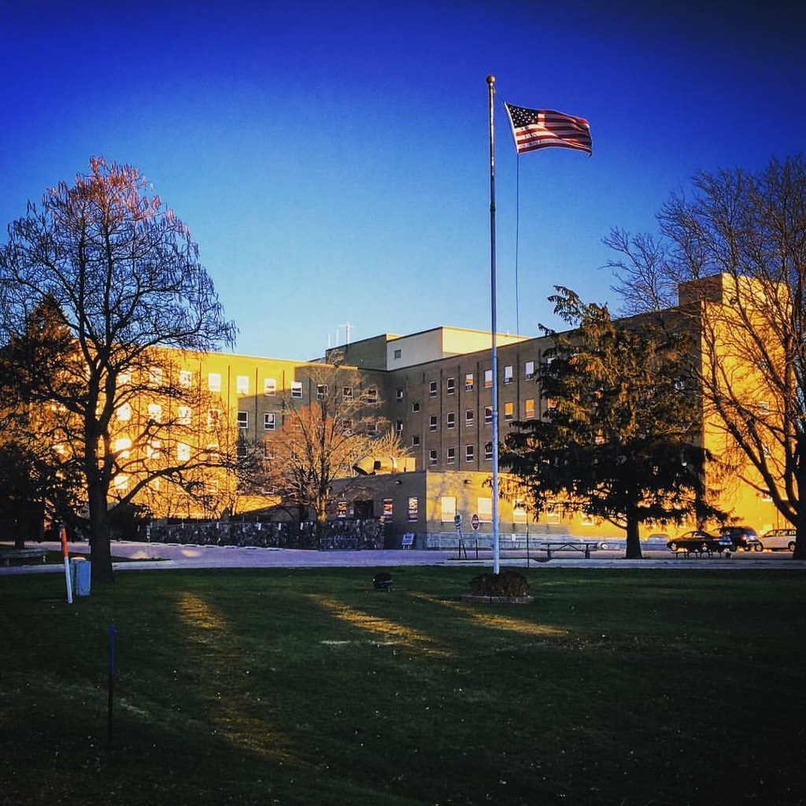
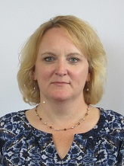
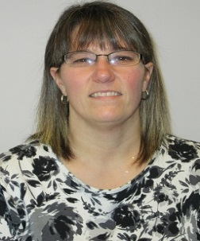
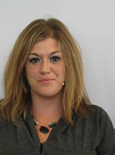
RoCk For Change CONSULT COLLABORATE CHANGE
TITLE
CHANGE TEAM
Supervisor- Bette Trimble
Court Services Officer- Linda Scott Hoag
Institutional Liaison- Heather Helgestad
Institutional Liaison- Melissa Lutz
ROCK COUNTY CRISIS SERVICES
2017

Slide 2
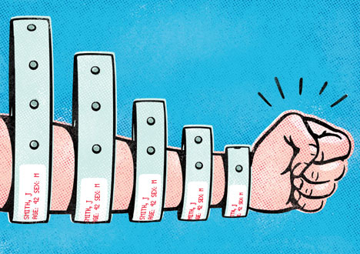
AIM
(PLAN)
READMISSIONS
TO WMHI
The Focus
In the 2015-2016 Fiscal Year Rock County Crisis Services readmissions to WMHI within 30 days was 8.4%
The Aim
Implement changes to decrease the number of readmissions to WMHI within 30 days to 6.0%

Slide 3
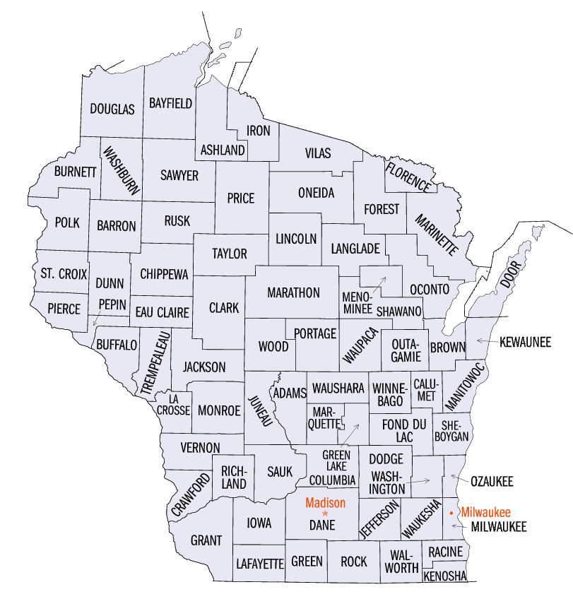
CHANGE
(DO)
1. Develop Triage Process
●Review and discuss each admission/discharge, known history, concerns, risks and needs to gain as much knowledge from natural supports or other treatment providers about character and appearance when stable.
●Talk with staff at WMHI consistently, including increased consults between WMHI psychiatrist and RC Psychiatrist.
Request records, medication lists and progress notes throughout stay, not just at admission.
●Increase HP referrals for people identified as likely return, increase CSCM referrals to ensure immediate involvement upon discharge.
2. Travel to WMHI to directly assess clients determined to be at risk for rapid readmission.

Slide 4
RESULTS
(STUDY)
12 Readmissions within 30 days to WMHI (10 distinct clients)
3 Readmissions were adolescents due to lack of Child/Adolescent stabilization options
2 of the Adult readmissions were associated with lack of protective placement options.
(If these 5 readmissions related to lack of respite/stabilization options are removed our readmission rate would be 6%.)
Overall WMHI admissions have been reduced by three a month.

Slide 5
NEXT STEPS
(ACT)
Adapt Dr. to Dr. consults earlier in admission, throughout admission and prior to discharge.
Continue taking an individual approach to determine stability by considering client’s unique sxs presentation.
Increase clinical staff at HP stabilization facility to try and reduce WMHI admissions in general.
Increase CSCM availability for clinical needs by providing Psych Tech support to assist with non clinical needs (ie; transports, appointments, ppw completion)
Abandon trips to WMHI due to time/staff constraints.

Slide 6
IMPACT
(LESSONS LEARNED)
Dr. to Dr. is most effective in slowing down discharges and assuring a client is stable enough to be successful upon discharge.
Transitioning client’s to a step down stabilization facility upon discharge or linking a client to CSCM services reduces likeliness of readmission.
Understanding and speaking directly to client, natural supports and those that know the client best is effective in assuring that discharge is not requested too soon and that when transitioning or discharging all involved are prepared and on the same page.
These strategies initially targeted WMHI admission but are now being utilized for all hospital admissions.

