Slide 1
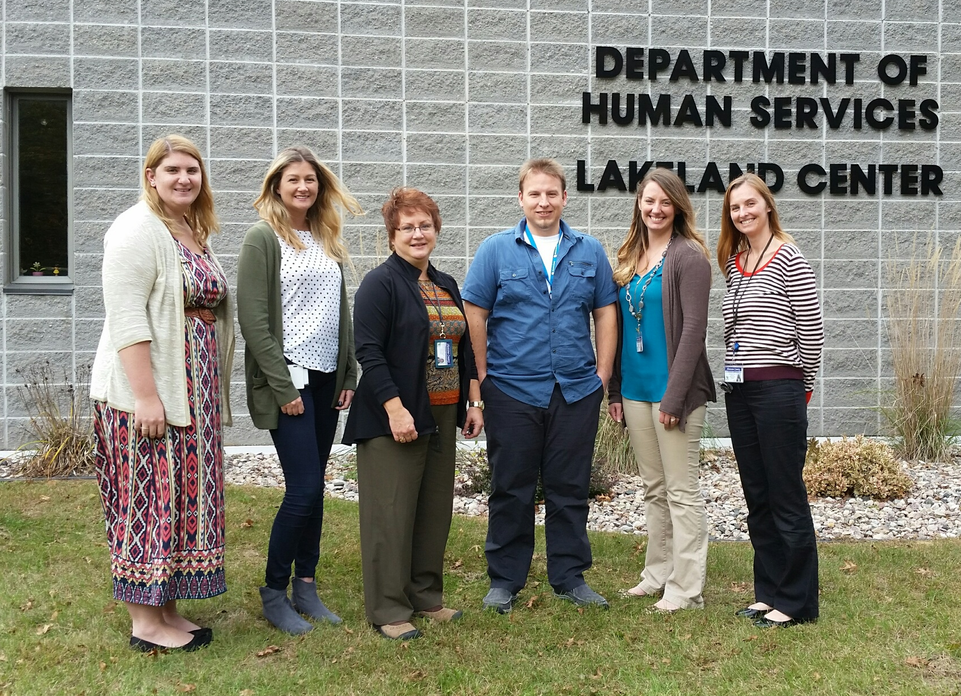
Shawano County DHS NIATx Project 2017
Follow up Upon Admission
&
Quicker Program Enrollment
Executive Sponsor: Jen Frost
Change Leader: Greg Bartell
Team Members: Alicia Elliott
Kaitlin Klitzke
Brenda Marquardt
Kendra Brusewitz

Slide 2
OUR AIM
BIG AIM:
Decrease inpatient admission rate. Shawano County readmission rate in 2016 was 13%. That is, 17 of 130 admissions were readmissions. Goal is to reduce this by more than half, to 6%. Average number of admissions per quarter in 2016 was 33. Goal is to have no more than 2 readmissions per quarter.
SMALL AIM:
Project #1 - Crisis staff will contact the patient to ask a series of five questions while in the hospital, prior to discharge, 85% of the time, from April to June of 2017, in order to improve the follow up process post discharge and assess for higher level of care within DHS system.
Project #2 - Crisis staff will proactively complete a Community Mental Health referral 90% of the time, from July to September of 2017, for those individuals who appear to be high risk, in efforts to put intensive services in place sooner.
EXPECTED IMPACT:
Reduce rate of readmissions of those individuals who would benefit from intensive services.
Reduce rate of no shows and cancelled outpatient appointments.
Longer engagement in services and less admissions to inpatient facilities.

Slide 3
First week impact
Phone call to patient asking five specific questions
Referral to Intensive Services (CSP, CCS, CLTS)
Follow up to ensure linkage to services
Inpatient Admission

Slide 4
Project #1
Goal Not
Met
DATA
Project #2
Not Statistically Significant

Slide 5
Lessons learned
Very difficult to remember to allow scheduled time to commit to trying to contact patient while in the hospital.
Found out that the number of clients that Change Project #2 impacted was not statistically significant.
Also tried to implement an employee satisfaction survey relating to burn-out and retention, thinking that satisfied employees will lead to 100% efforts to reduce client hospital readmissions. This was not approved by our director, so it never materialized.

Slide 6
Next steps
Efforts will focus on 2018 Change Project with finally-achieved staff stability, including crisis staff and psychiatry.
Will attempt to pitch an idea where a block of psychiatric time gets left unscheduled with anticipation of filling this time with emergency appointments relating to patients coming out of the hospital and those who will be out of medications prescribed while at inpatient facility.
This idea results from the ongoing problem of a gap in time where clients who have been recently hospitalized do not have medications after their prescriptions have run out while waiting to see county psychiatrist. This could mean anywhere from 30-90 days without medications.
This would definitely reduce inpatient readmissions.

